Slide 1
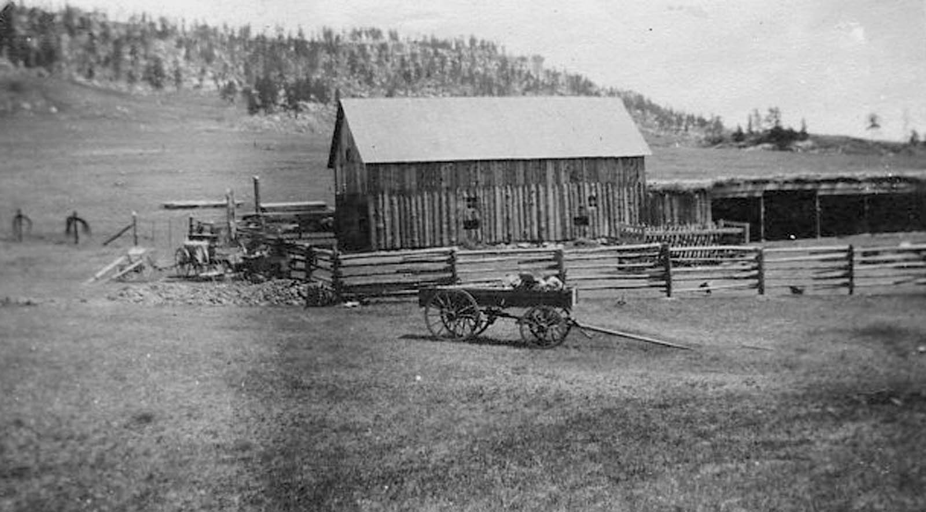
Higginson’s Life in Divide Country
Established 1907 Greenland, Colorado
Beverly Higginson Noe
June 12,2006

Slide 2
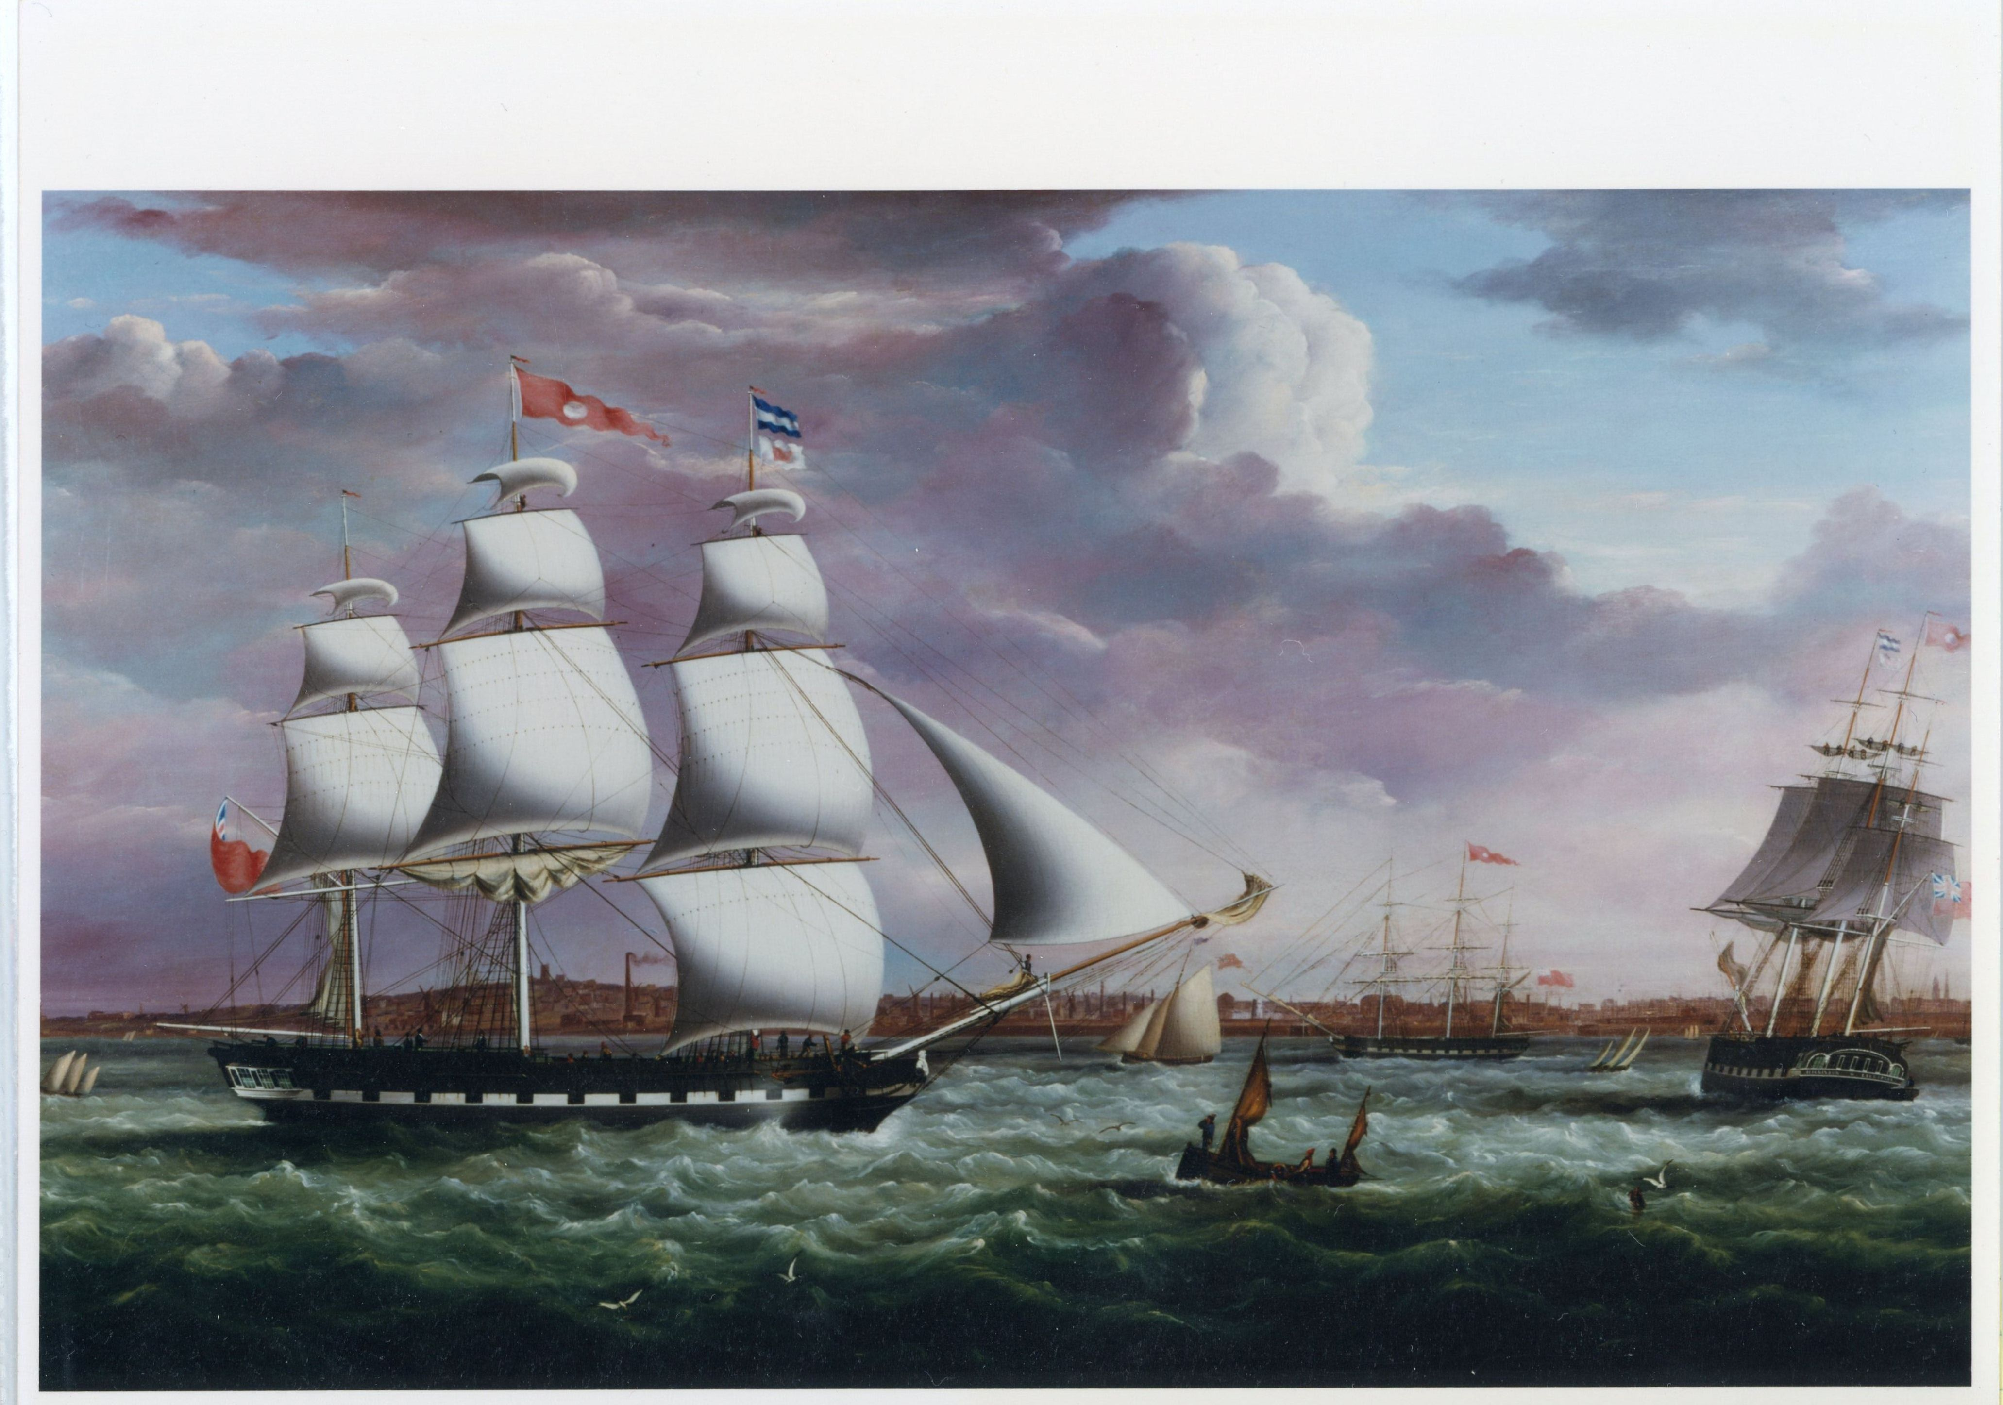
My Higginson’s in Colorado came from the decedents of my Great, Great, Grandfather Jonathan Higginson (1807-1859) who was a partner in a fleet of 40 ships known as the Barton, Irlam, and Higginson Company headquartered in Liverpool, England.
They made a fortune hauling cargo, soap, window glass, livestock, coal, clothing, crockery, lumber, food, sprits and passengers to Barbados and other West Indies ports. Sometimes sailing to Charleston and Baltimore in the U.S. They returned with spices and other goods.
Unfortunately, the Bank of England went bankrupt in 1853 and called in all the notes of the shipping company. They lost about 5 million pounds of sterling. In the 2026 market that would be about $6 Billion.
Oil painting of “Higginson” Ship part of the fleet of 40 ships
Higginson Ranch Presentation BJN 2026

Slide 3
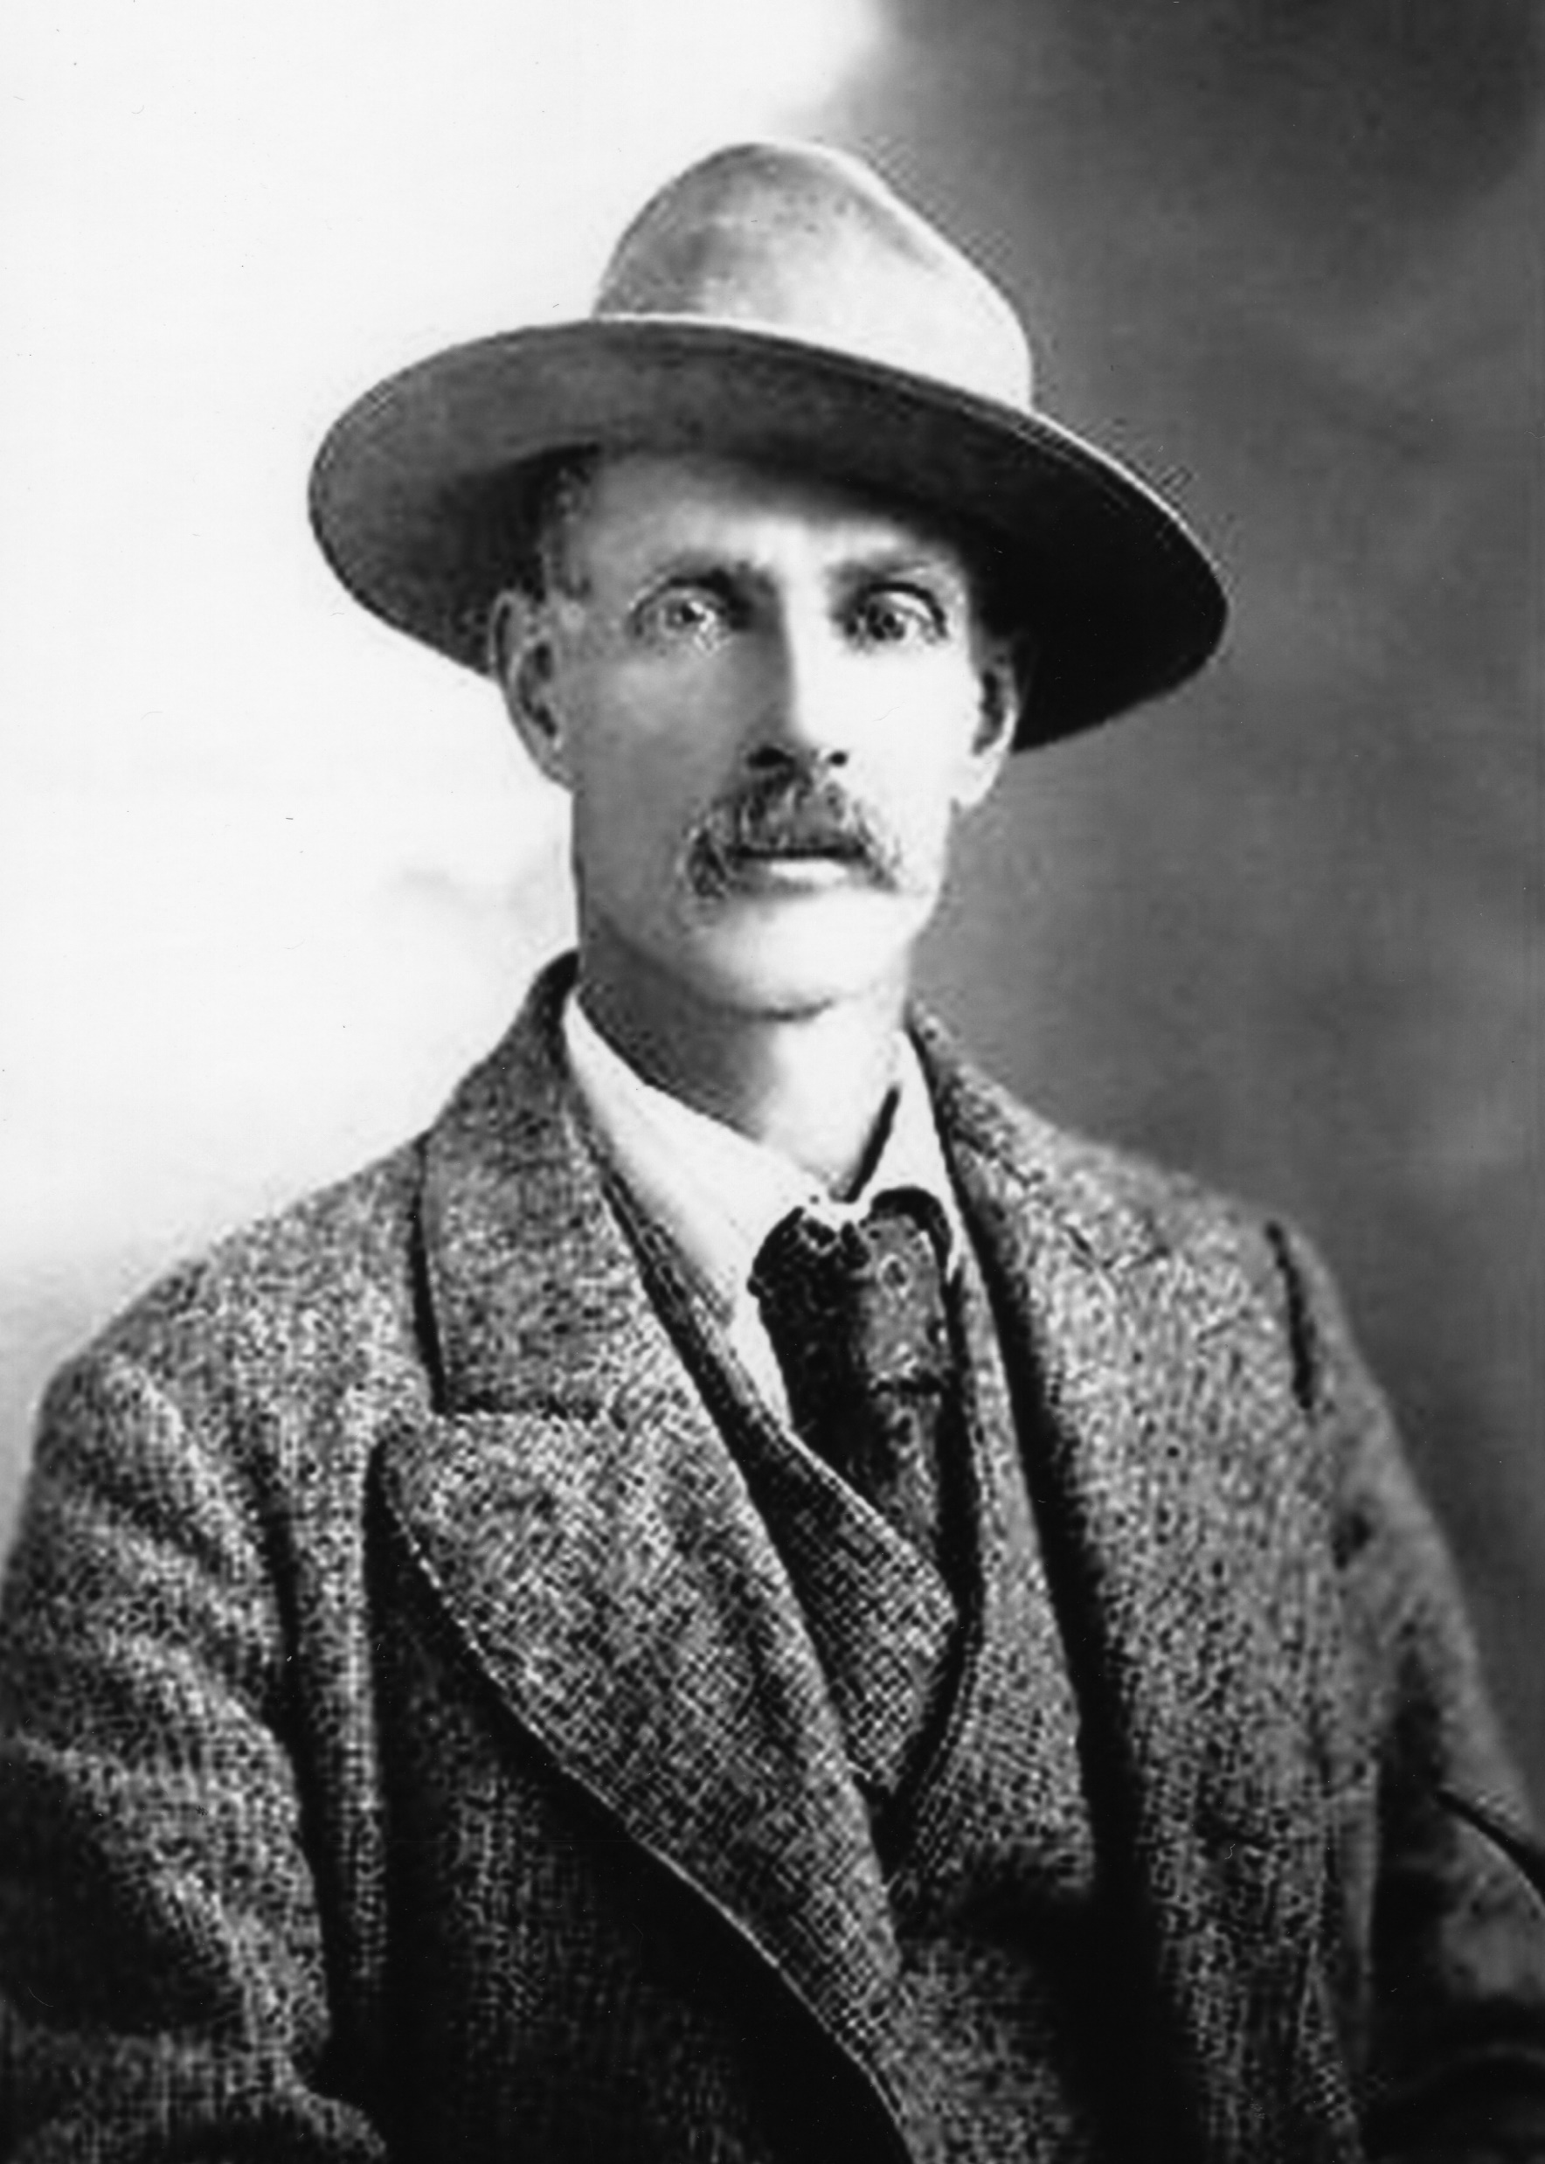
My Great Grandfather, Johnathan Higginson (1848-1917), at age 20, after hearing from some hunting buddies’ tales of the “wild and free life” they had experienced in Colorado packed his belongings and within 2 weeks Johnathan boarded a ship for New York and arrived in 1869. He caught a train to Colorado.
After arriving in Denver, he formed a business hauling freight with a team of oxen. He hauled this freight by way of the North Platte River Road to Deckers, then to the mining towns of Breckinridge and Leadville. The narrow-gauge railroad took over the route and the oxen hauling freight were no longer needed.
Jonathan Higginson (1848-1917)

Slide 4
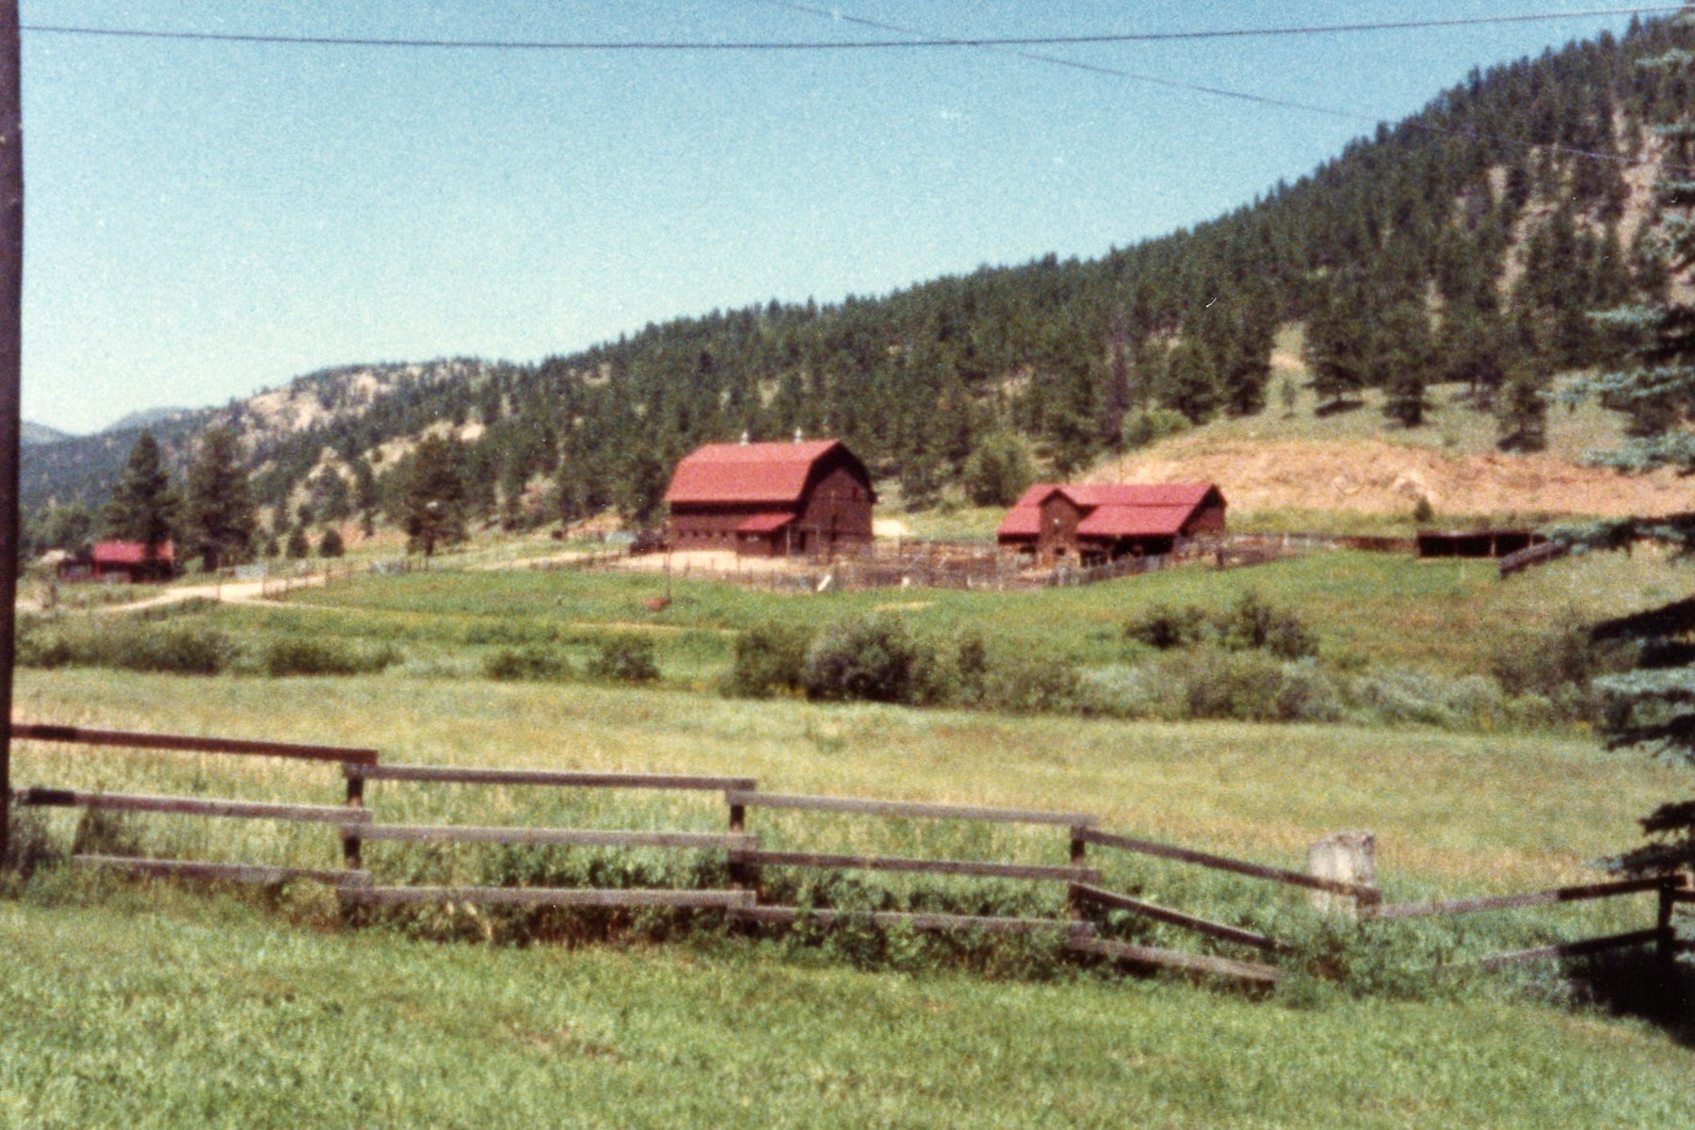
Higginson Hay Ranch (Swan Ranch)
In 1872 Jonathan established the Higginson Hay Ranch (now known as the Swan Ranch) of about 1,280 acres right along the North Platte River near the town of Buffalo Creek.
During that year his mother, Charolette, and siblings, Arthur and Emily, arrived from England and added another 1000 acres to the west of the homestead. The verbal history tells us that Wellington Lake covers part of the buildings now.

Slide 5
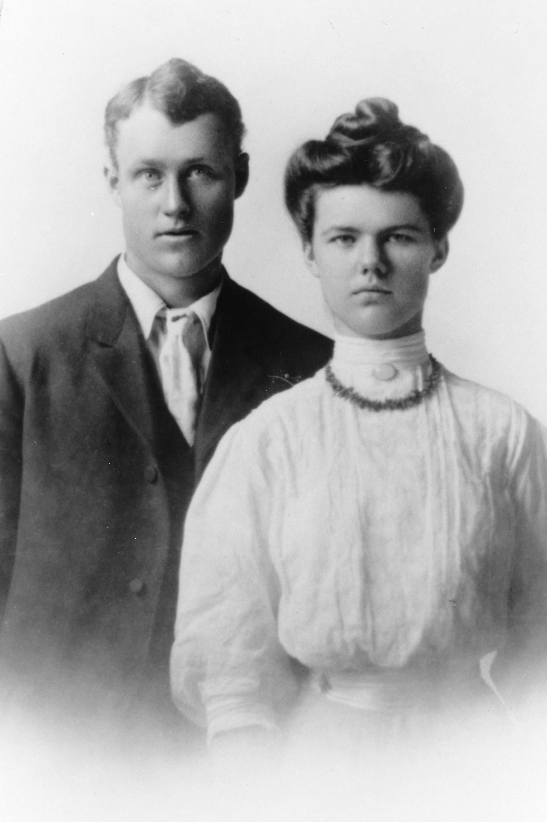
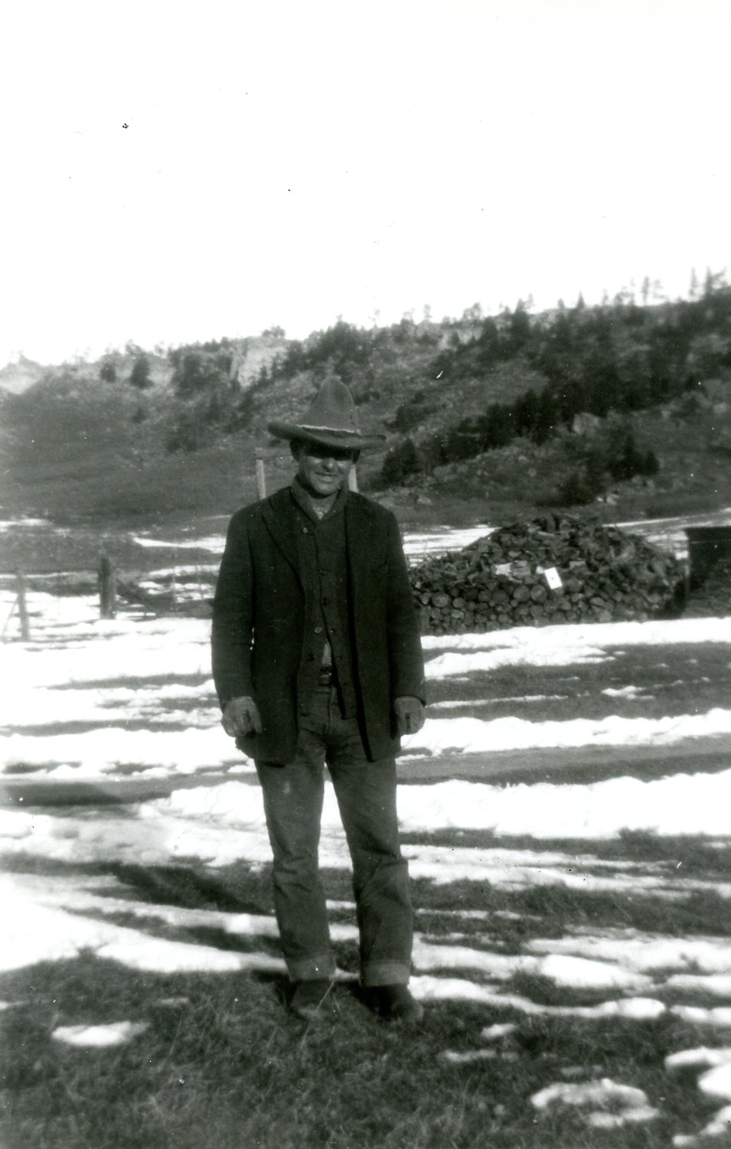
My Grandfather, Harold Higginson, grew up in the Buffalo Creek area and married a local woman, Essie Voorhees. Harold and his brother, Arthur purchased 2080 acres of the Ben Lomond Ranch in Douglas County in 1907.
Harold and Essie Higginson 1907
Harolds brother Aurther Higginson

Slide 6
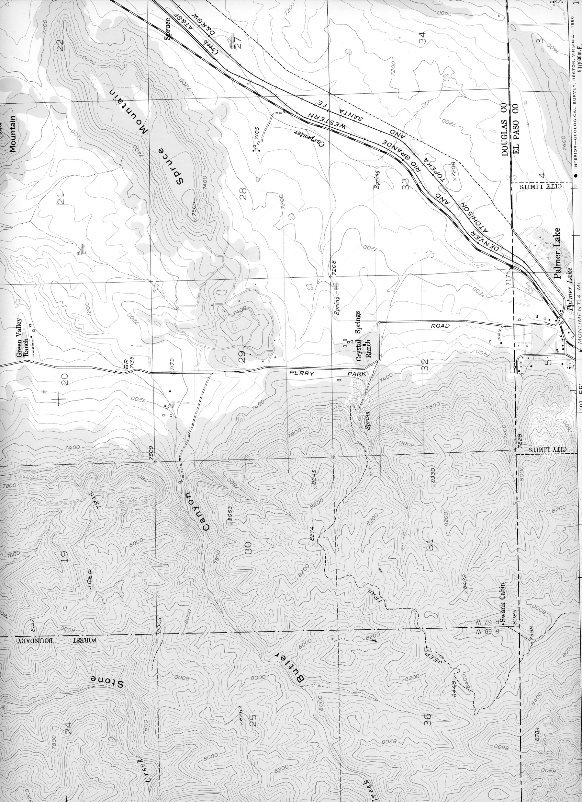
Location of Douglas County Higginson Ranch
This acreage was located North of the El Paso and Douglas County line and North of Palmer Lake. Arthur’s 1040 acres was East of the railroad tracks along the county line. Harold owned 1040 located between the railroad tracks and north toward Spruce Mountain. The ranch buildings were on the West side of the railroad tracks and on the south side of Spruce Mountain. This acreage went west. There were about 680 acres on the West side of Perry Park Road. The mostly forested property was located approximately between Butler Canyon on the North and Hanks Canyon on the South. Within Harold’s acreage, was the Shubarth wagon trail that went on to Woodland Park and Colorado City. The Shubarth sawmill, Palmer Lake Park subdivision and the Russell Mine were also on the property. The old Greenmount Cemetery (1860s to 1920’s) was located in Arthur’s acreage on Range 10, Township 64 and Section 34.
Harold Higginson
Harold Higginson
Arthur Higginson

Slide 7
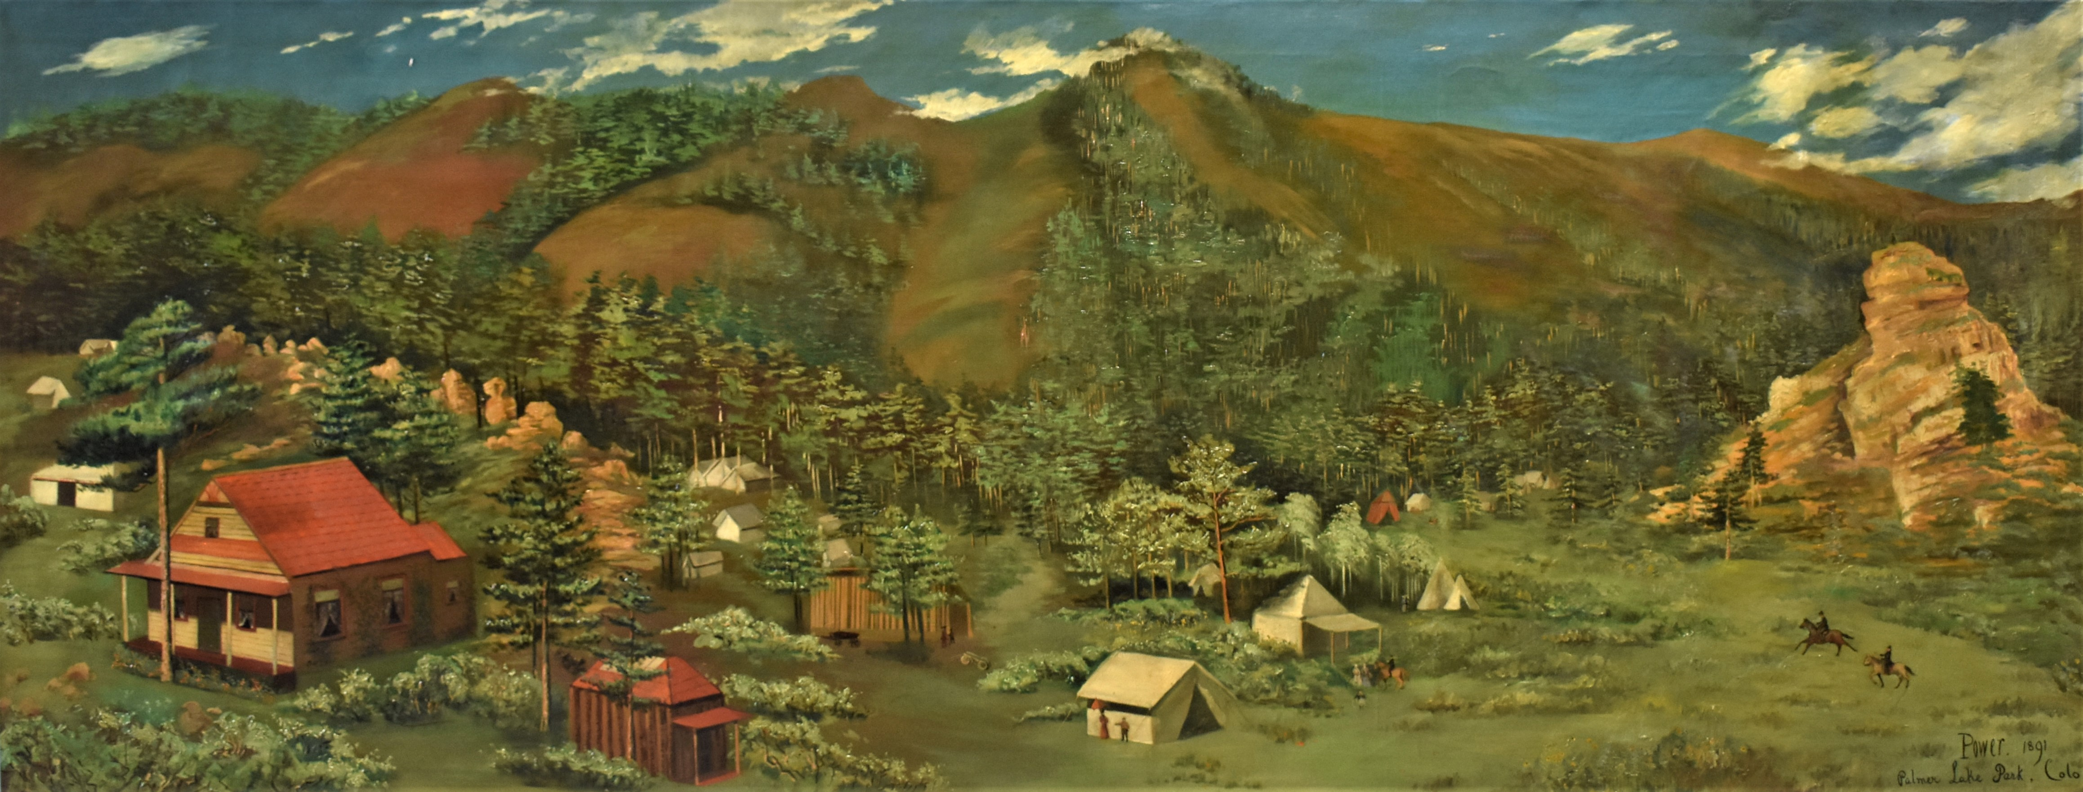
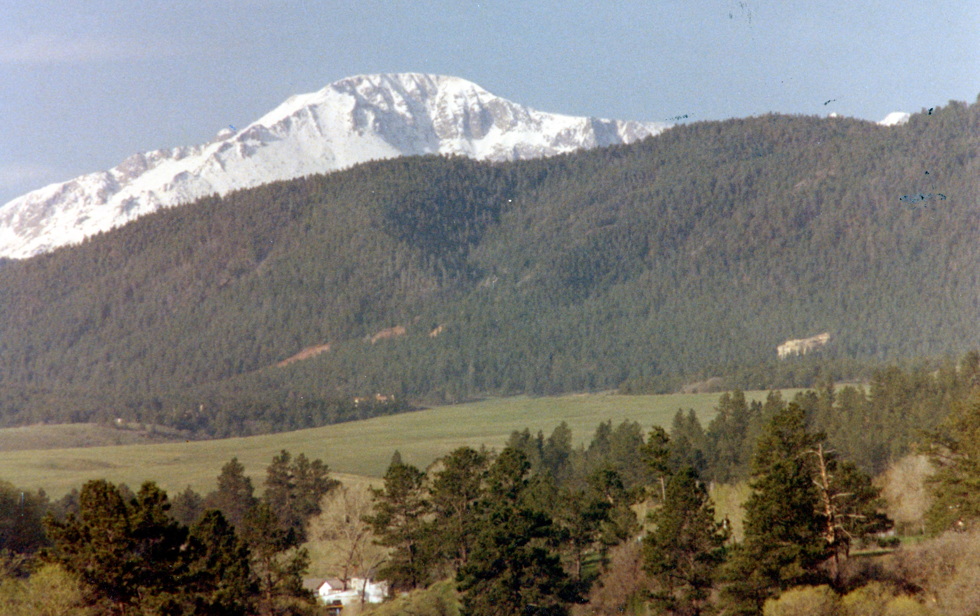
Helen De La Poer Power’s 1891 Painting of Palmer Lake Park
1980 Palmer Lake Park Area
The subdivision was 160 acres located in Douglas County North of the town of Palmer Lake. This was on the West side of Perry Park Road at the junction of Yarnell Drive. There were more than 750 lots available for sale.

Slide 8
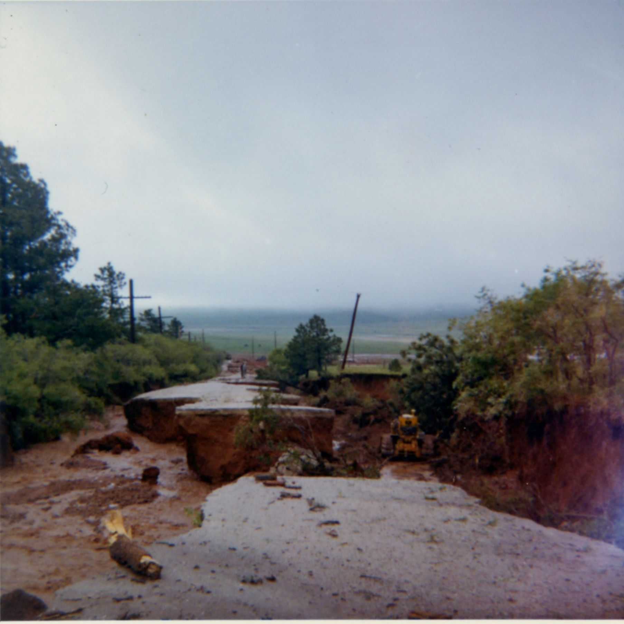
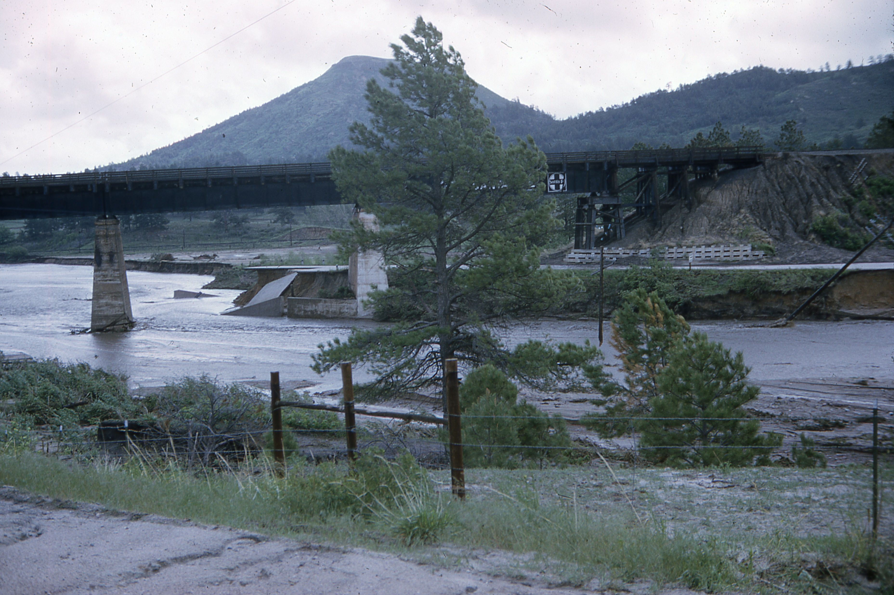
The elevation at the ranch buildings at the base of Spruce Mountain is 7105 feet and on the highest point on the west property is 8345 feet. Since the flood of 1965 originated at this Divide Area you can see how an enormous amount of water pushed its way North and flowed into East Plum Creek.
Perry Park Road 1965 flood near Hanks Canyon
There are 3 creeks running through the property. Carpenter Creek flows north out of Palmer Lake and down through the meadows, Wilson Creek flows down Hanks Canyon joining Carpenter Creek and Cook Creek flows down Buttler Canyon to East Plum Creek.
1965 flood picture of the railroad trestle at the south end of Larkspur

Slide 9
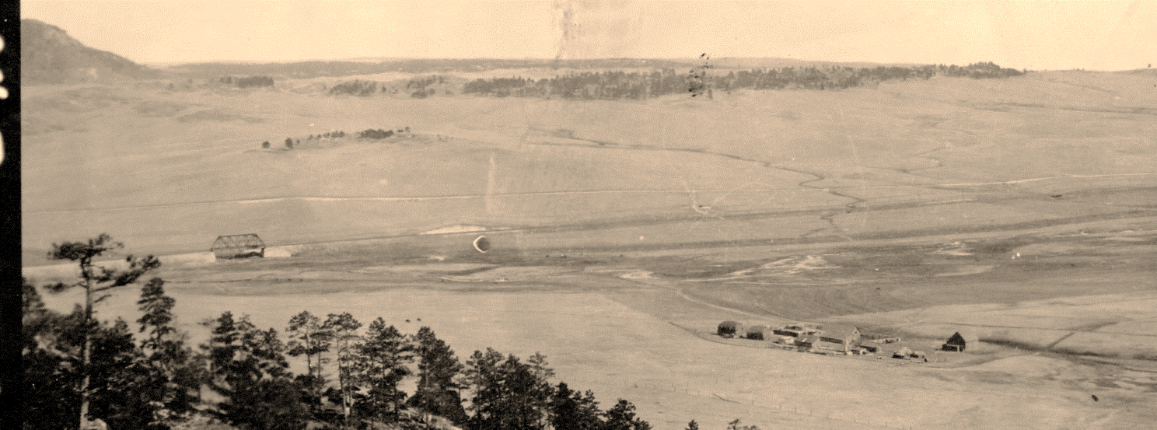
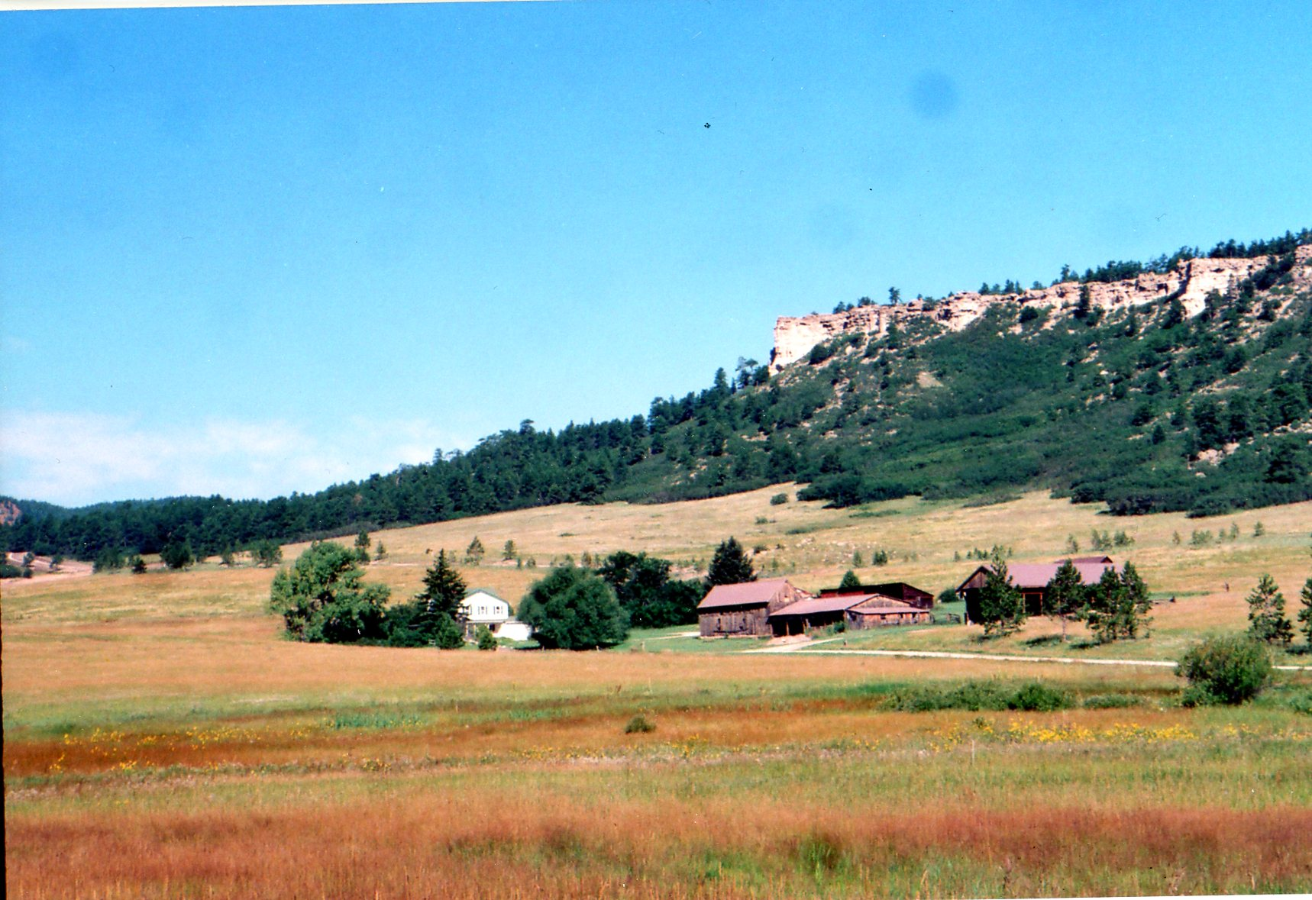
1915 photo taken from the top of Spruce Mountain Looking Down on Higginson Ranch
There were the Sante Fe Railroad and the Denver and Rio Grande railroads running through the ranch. The US Highway 85 (Spruce Mountain Road) was constructed through the Higginson property in 1928. In addition, on the West Ranch property the Perry Park Road (HWY 105) went across to Palmer Lake.
1999 photo of Higginson Ranch

Slide 10
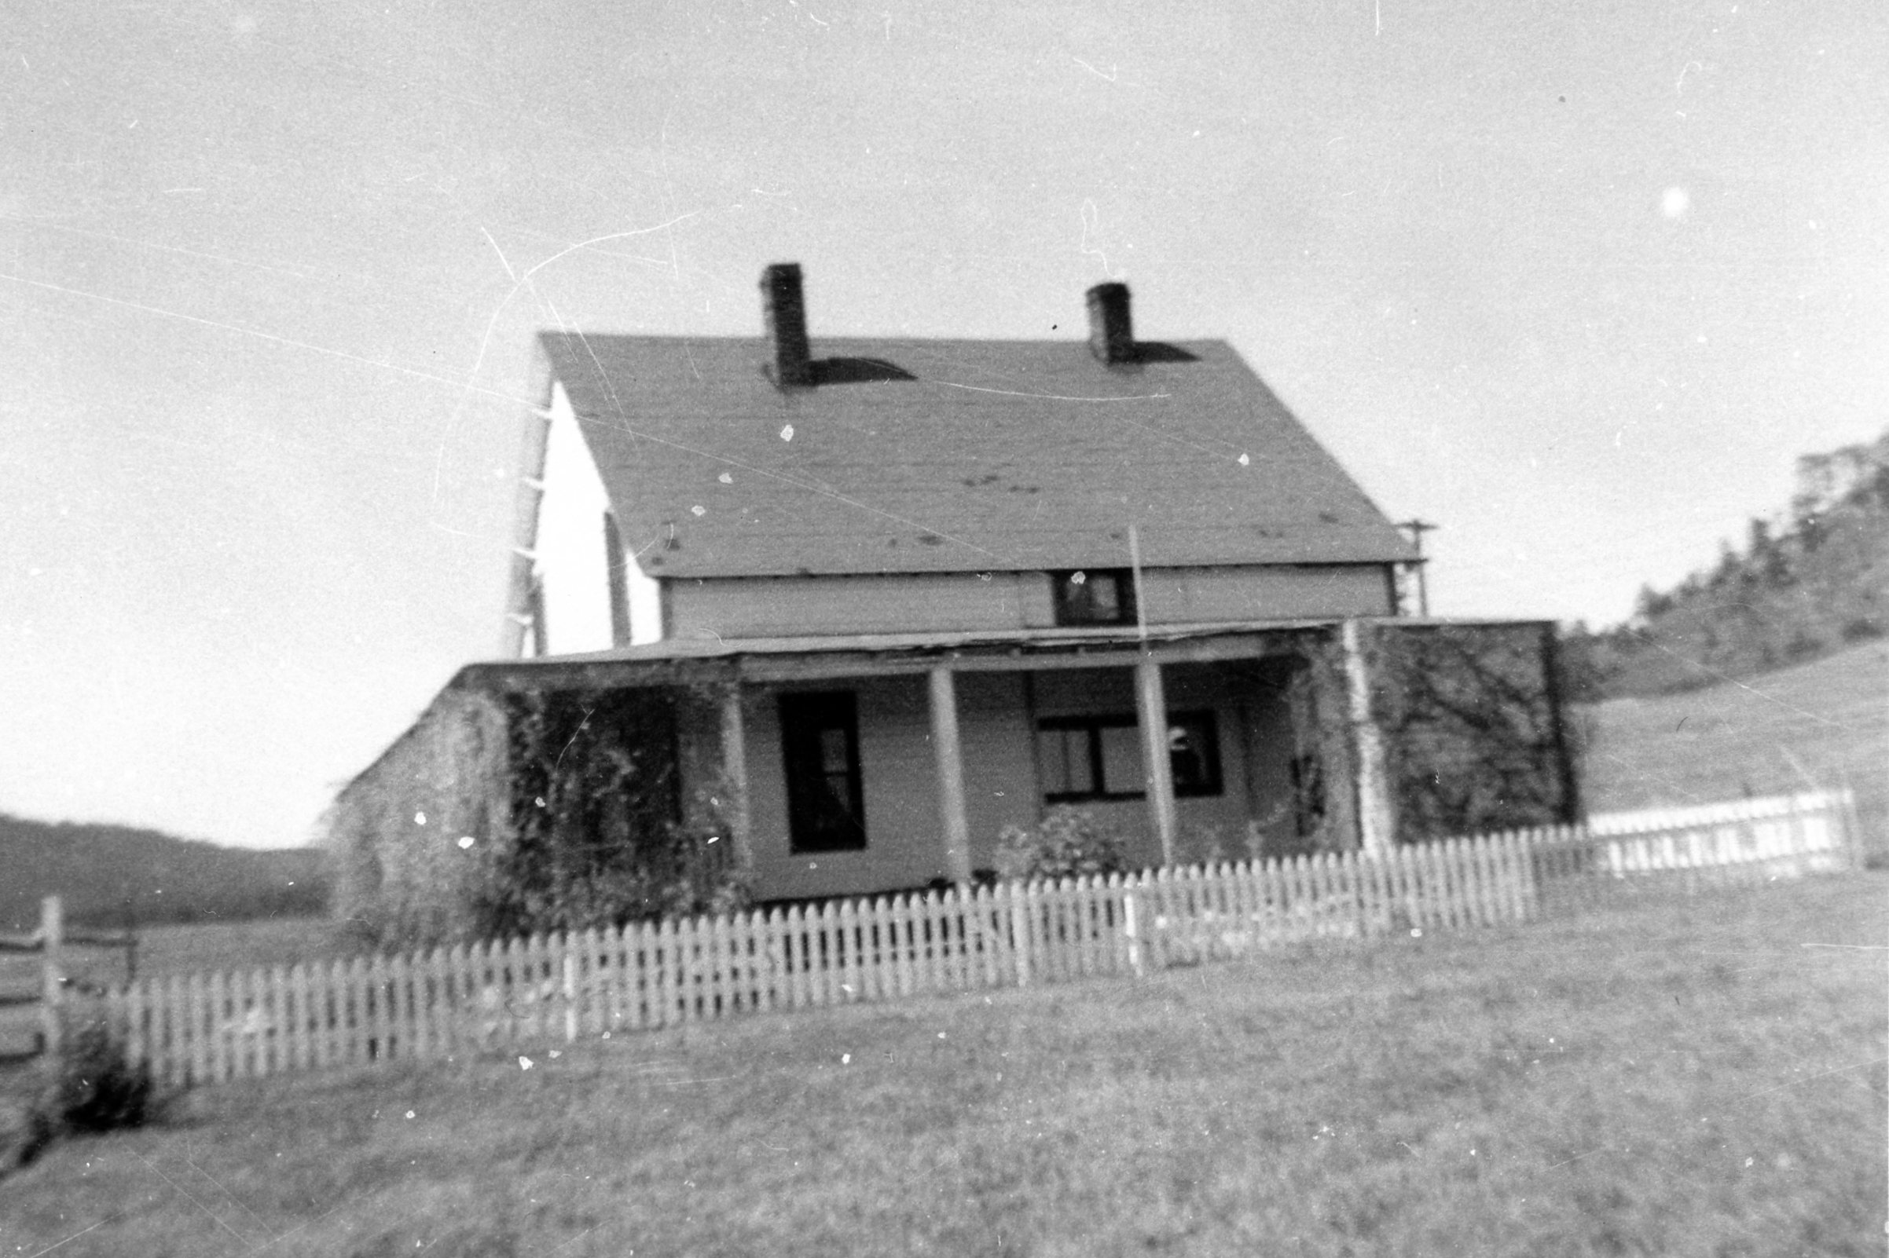
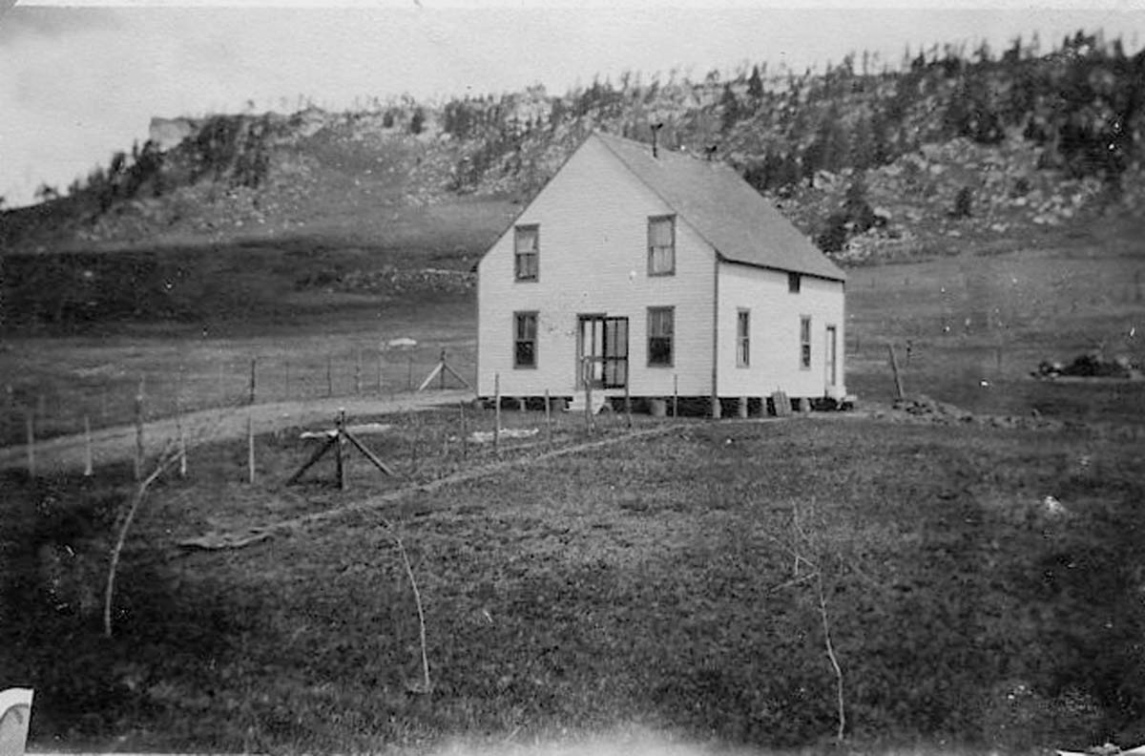
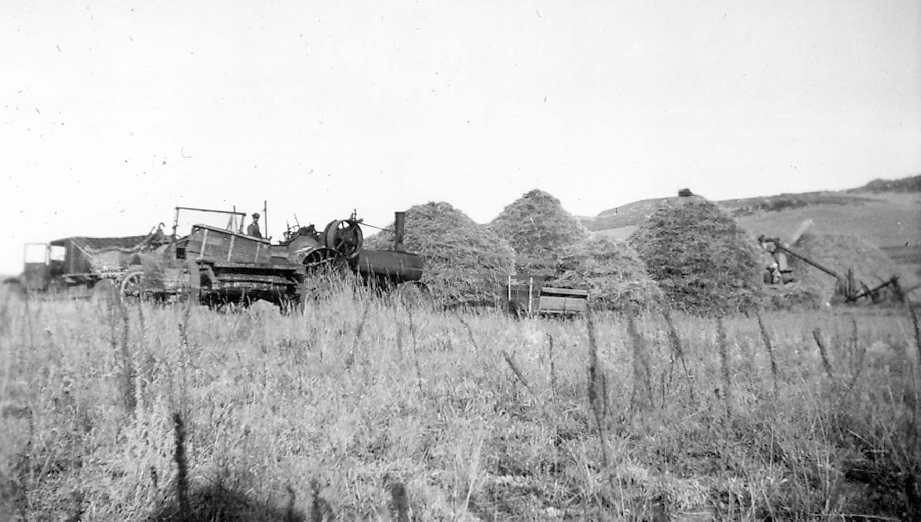
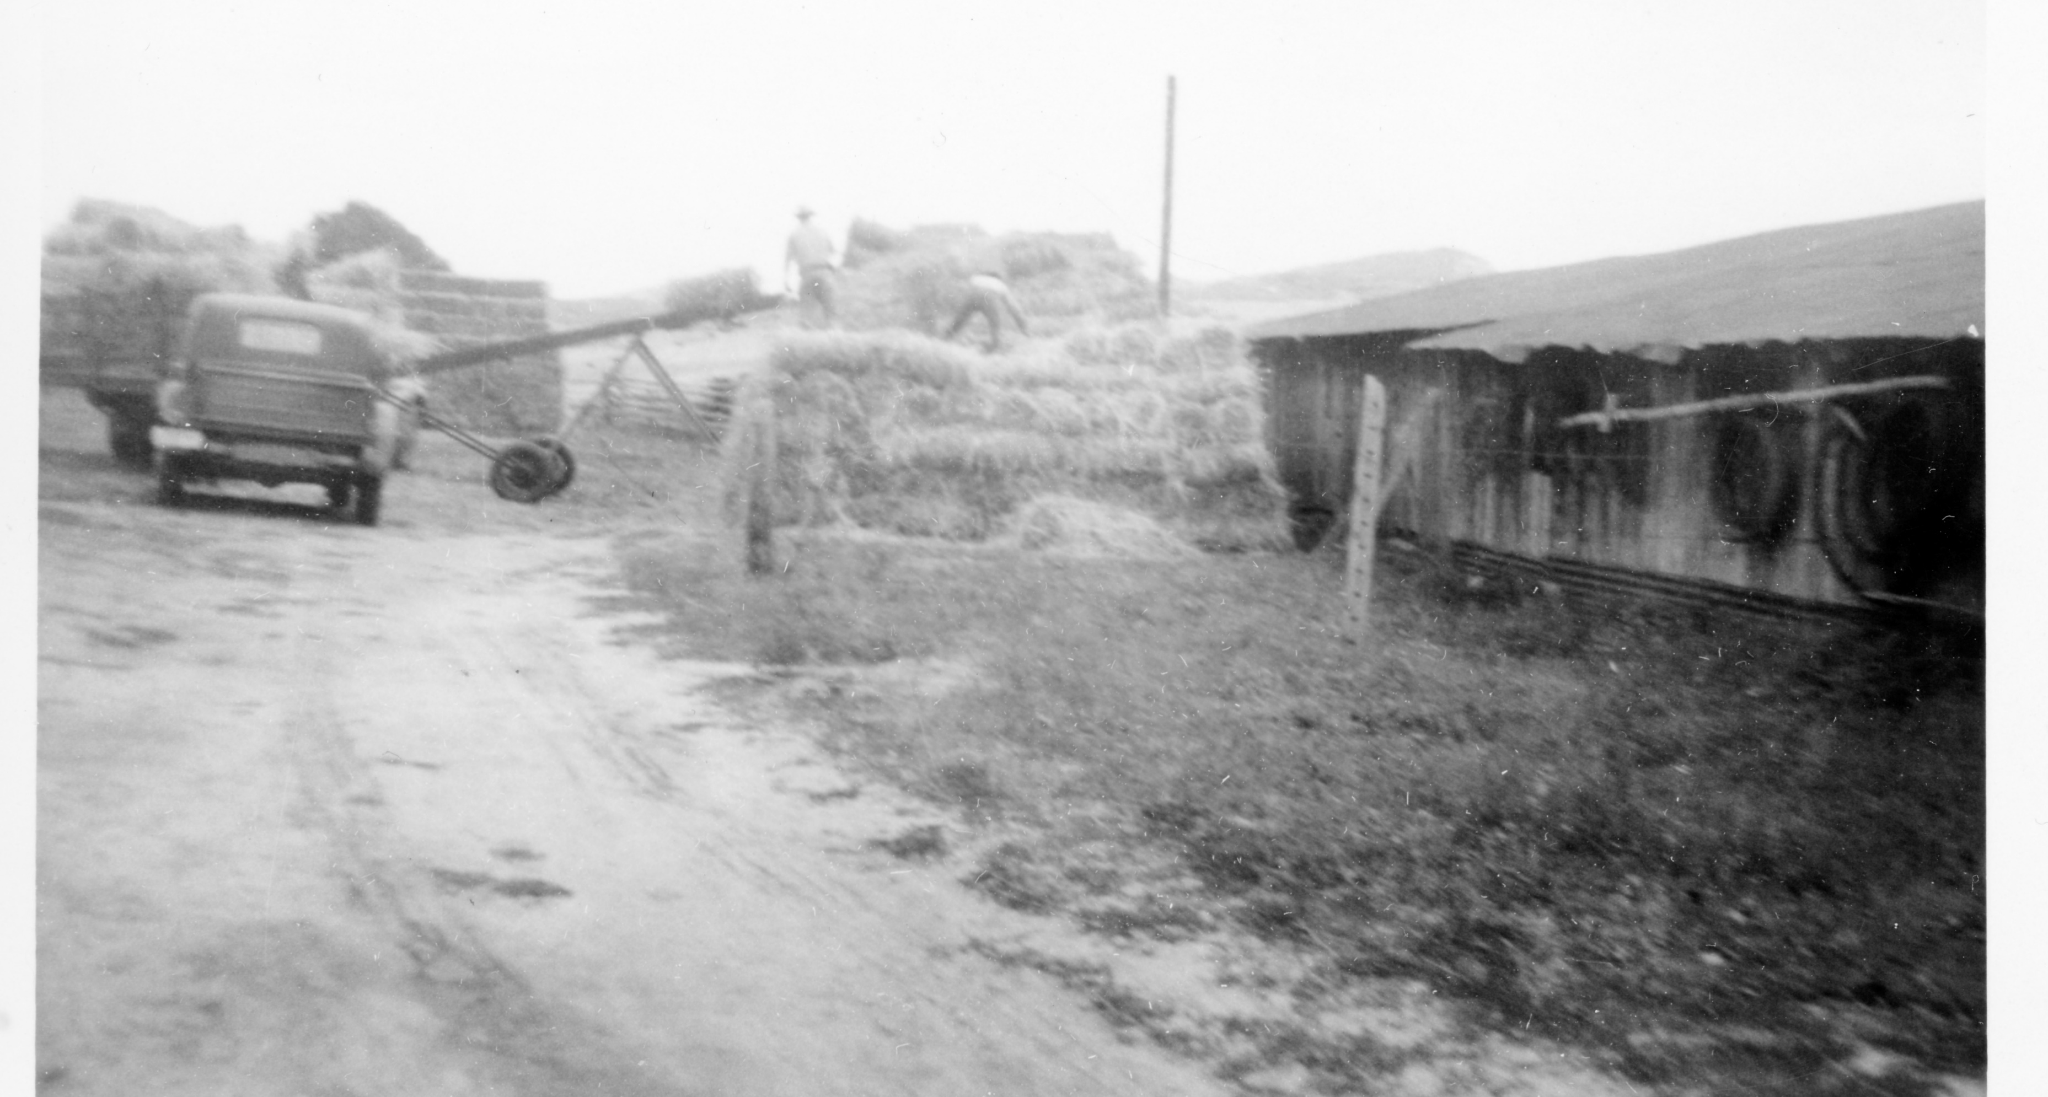
The ranch house and barn were built between 1907 and 1908 by Harold while he and Essie lived in Palmer Lake. They raised a total of five children, Robert, Russell, Esther, Albert and Janet while working the ranch. They raised Herford cattle, milk cows, meadow hay, oats and other grains, they also sold saw logs to the Olson Sawmill.
Arthur decided it was “too flat” and moved back to his ranch on Turkey Creek. Later selling his portion of the property to Eugene Higby in 1932.
Higginson Ranch House
Stacking Hay at the Higginson Ranch
Stacking bailed Hay in the 1950’s

Slide 11
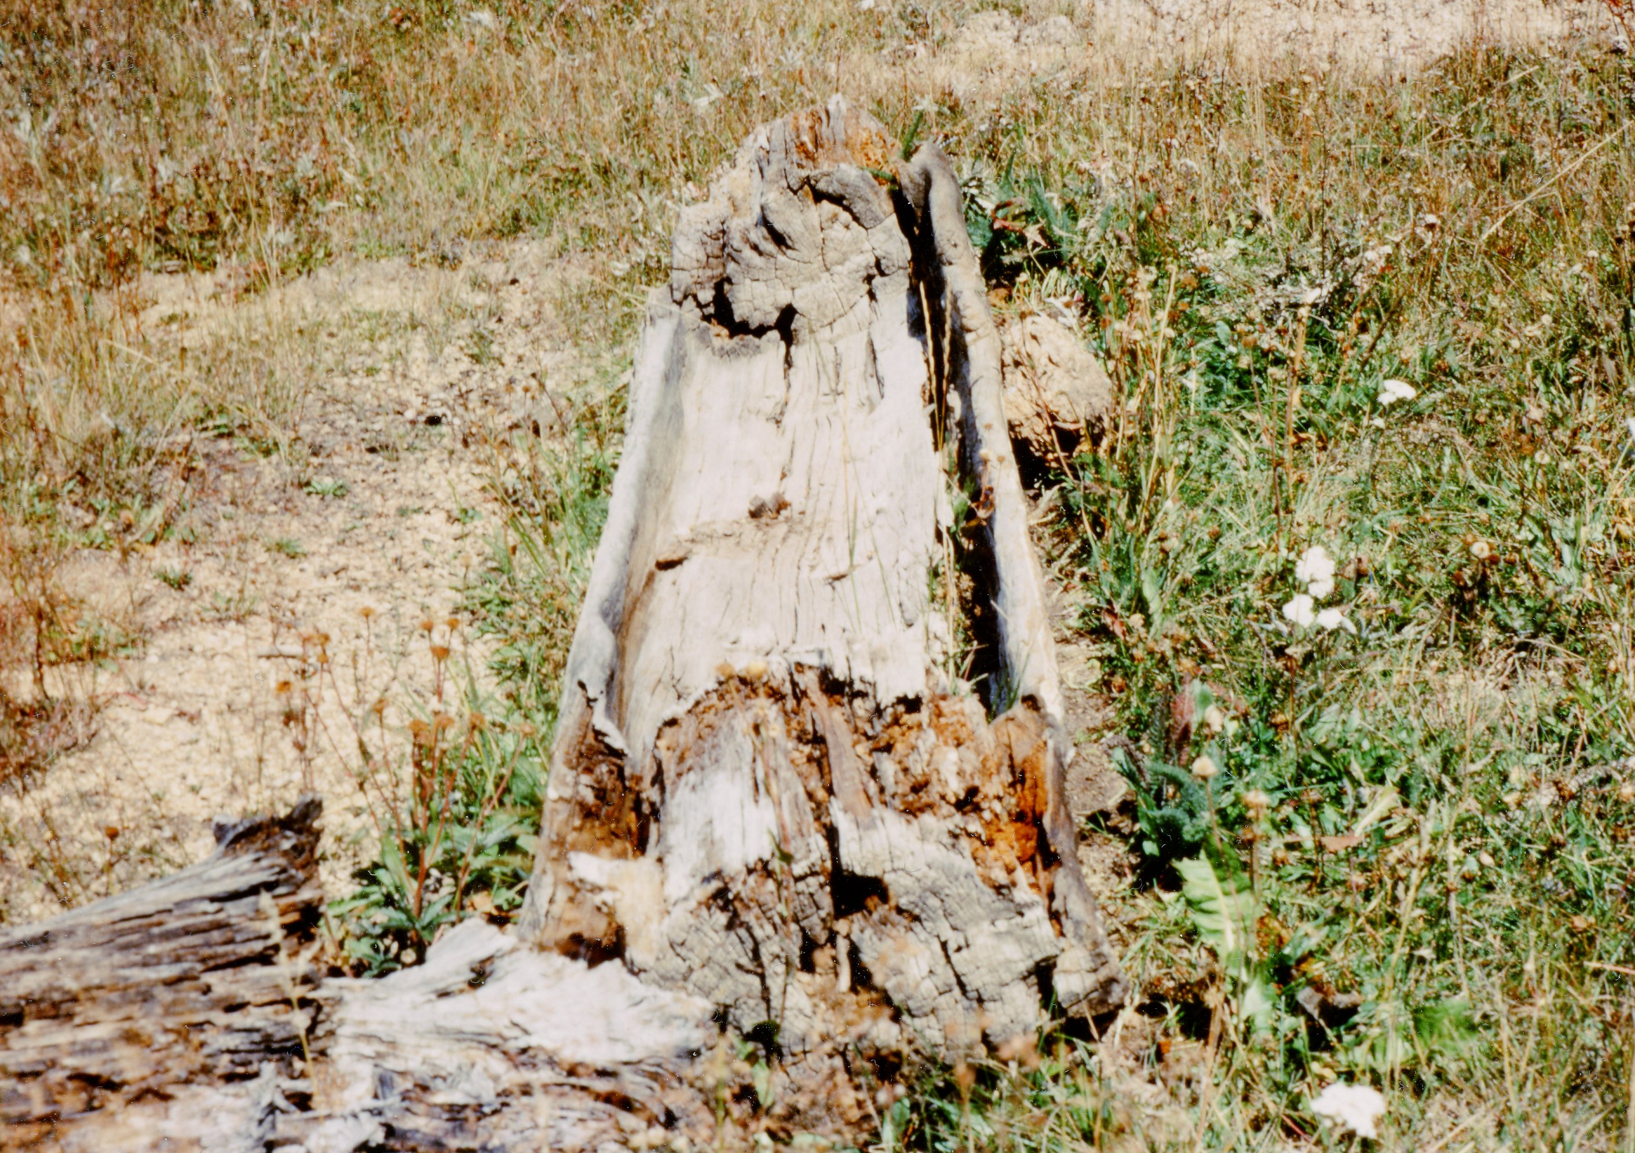
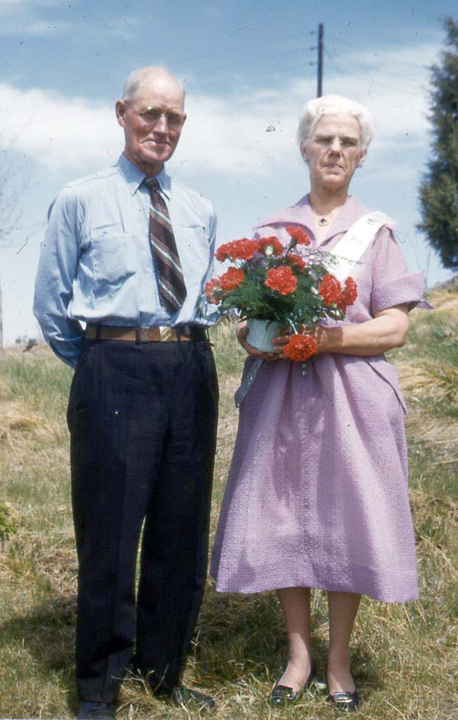
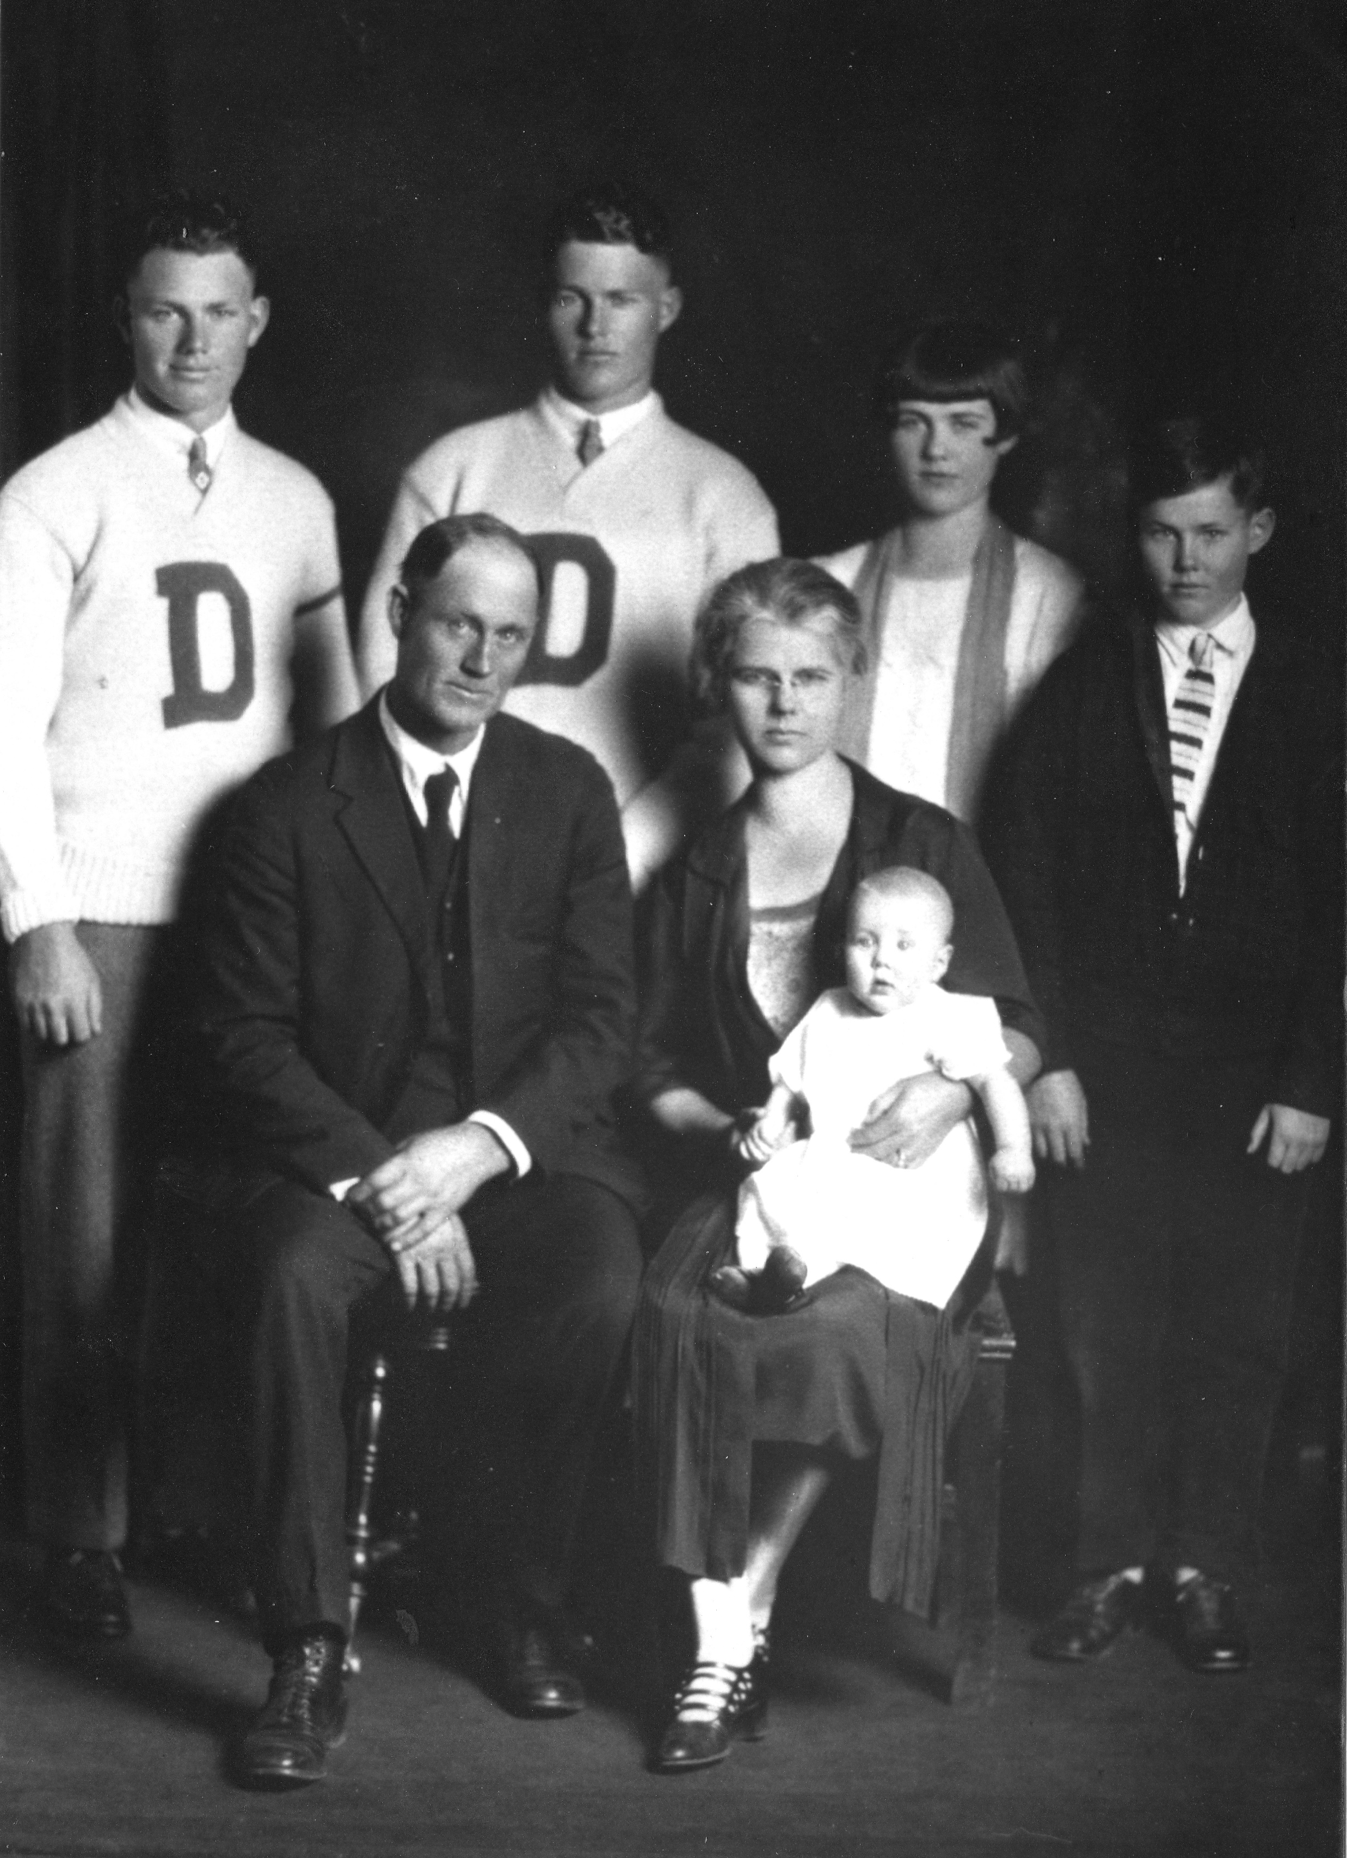
Many of the ranchers between Monument and Sedalia held National Forest grazing permits. They drove the cattle to the mountains in the spring and had a big round up and branding in the fall at the Douglas County Grower’s Association corrals on the Dakan Ranch.
During the summer each owner checked the cattle, hauled wagon loads of salt to leave in salt logs and home comforts to the line cabin. As the cows ate their way north, everyone took a turn caring for them. The Harold Higginson Brand was “KL” and my dad’s Bar R lazy H.
Salt Log in National Forest
R
H
KL
Branding at Higginson Ranch

Slide 12
Essie, Russell, Esther, and Albert
The four older children rode their horses the 3 miles to the Greenland school. All graduated from Douglas County High School on Wilcox Street.
Robert (1908-2002) the oldest of the Higginson children went to California for an education in electrical engineering, returning to Colorado and was foreman at the IREA in Sedalia, Colorado most of his career. Esther (1912-1991) married a Palmer Lake Railroad Station Master and lived in Palmer Lake the rest of her life. Albert (1915-1954) was involved in ranching in Steamboat Springs, Colorado and Douglas County most of his life. Janet (1927-1936) contacted Scarlett Fever which took her life at age 9.
The Harold Higginson family was rather adventurous. In 1929 Harold and Essie packed up the car and took off cross country to visit Essie’s father and family in California. On the way they toured Yellowstone, drove down HWY 101 from Oregon, saw Yosemite and visited family. All of this with 7 mostly grown children and a 1 1/2 year-old in diapers.
Russell, Robert, Esther, Albert,
Harold, Essie and Janet Higginson

Slide 13
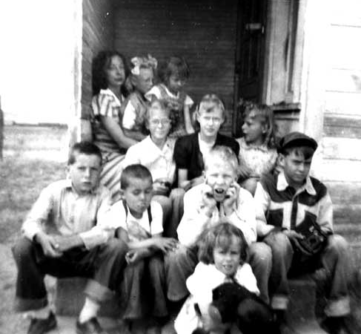
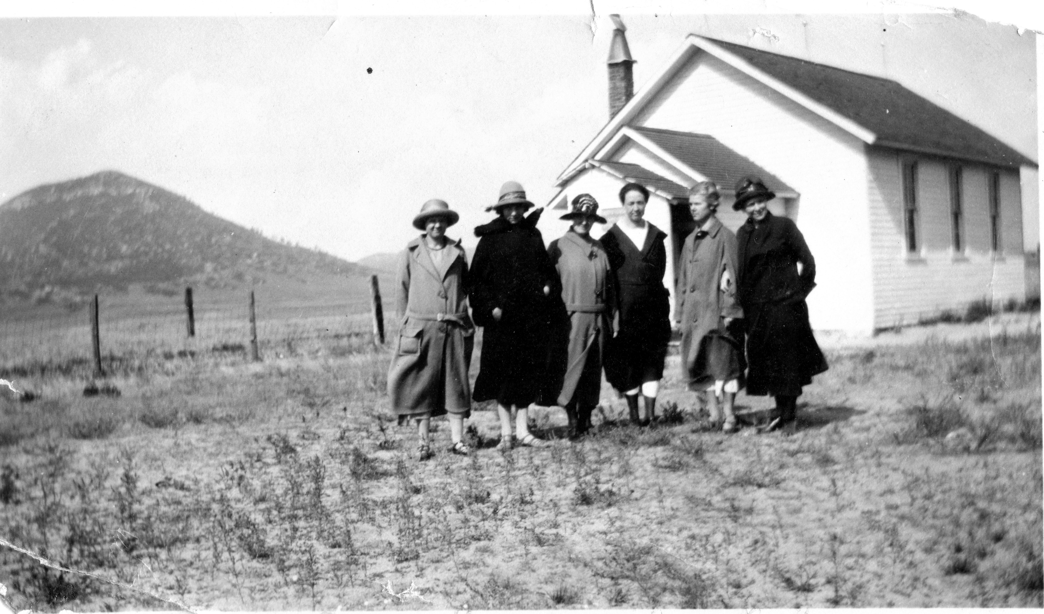
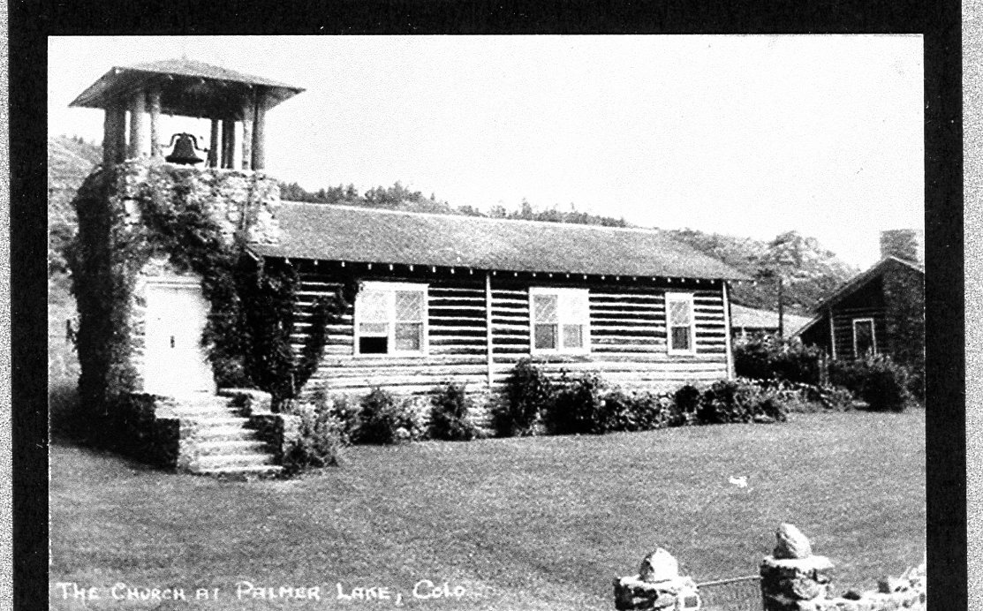
My Grandparents were involved in the community activities. Grandmother Essie raised a large vegetable garden and preserved food for the family while supporting her children’s education at the Greenland School. She was instrumental in the planning and the construction of the Little Log Church in Palmer Lake which was completed in 1924. She was also active in the local Home Demonstration Clubs.
As the children entered Douglas County High School, she rented a house in Castle Rock during the winter and she and the children lived in town during the week. She and Harold also moved to Fort Collins to support my dad during his college education.
Russell, Robert, Esther, Albert,
Harold, Essie and Janet Higginson
1950 Greenland School Children
Teacher Alice Hognal upper left
Beverly Higginson 2nd row far right
Mother’s at the Greenland School
Little Log Church at Palmer Lake
Essie Higginson 2nd from right

Slide 14
Lighting at Devils Head
Devils Head with Pikes Peak
Harold spent 12 summers, after most of the kids were grown, as the Devils Head Fire Lookout Ranger. Essie and the youngest daughter, Janet, would spend some time with him in the cabin near the tower. During these summers he rented the ranch out for haying. Essie and Janet, would spend some time with him in the cabin near the tower. Essie and Janet gathered wild raspberries and made jam on the wood stove in the cabin. During the summer of 1933 Harold’s sons Robert and Russell worked for the United States Forest Service to construct a telephone line to the Lookout Station. This was accomplished with horses and mules.

Slide 15
1918 WWI Soldiers on railroad trestle at Higginson Ranch
The Higginson Family were asked to help the country with some Homeland Security for WWI in 1918. There were two railroad companies that had tracks crossing the ranch. The Atchinson, Topeka & Santa Fe railroad tracks crossed over the Rio Grande tracks on the trestle less than a half mile east of the ranch house. The government sent soldiers to guard this important transportation location and the Higginson family provided housing, food and some entertainment to the soldiers.
Just north of the trestle there is a Rhyolite bridge over Carpenter Creek that is still there today. The Spruce Train Station was located further north in an old railroad boxcar.
Interestingly, the Greenland area and its railroad tracks are still on the Homeland Security list, hosting multi agency trainings there.

Slide 16
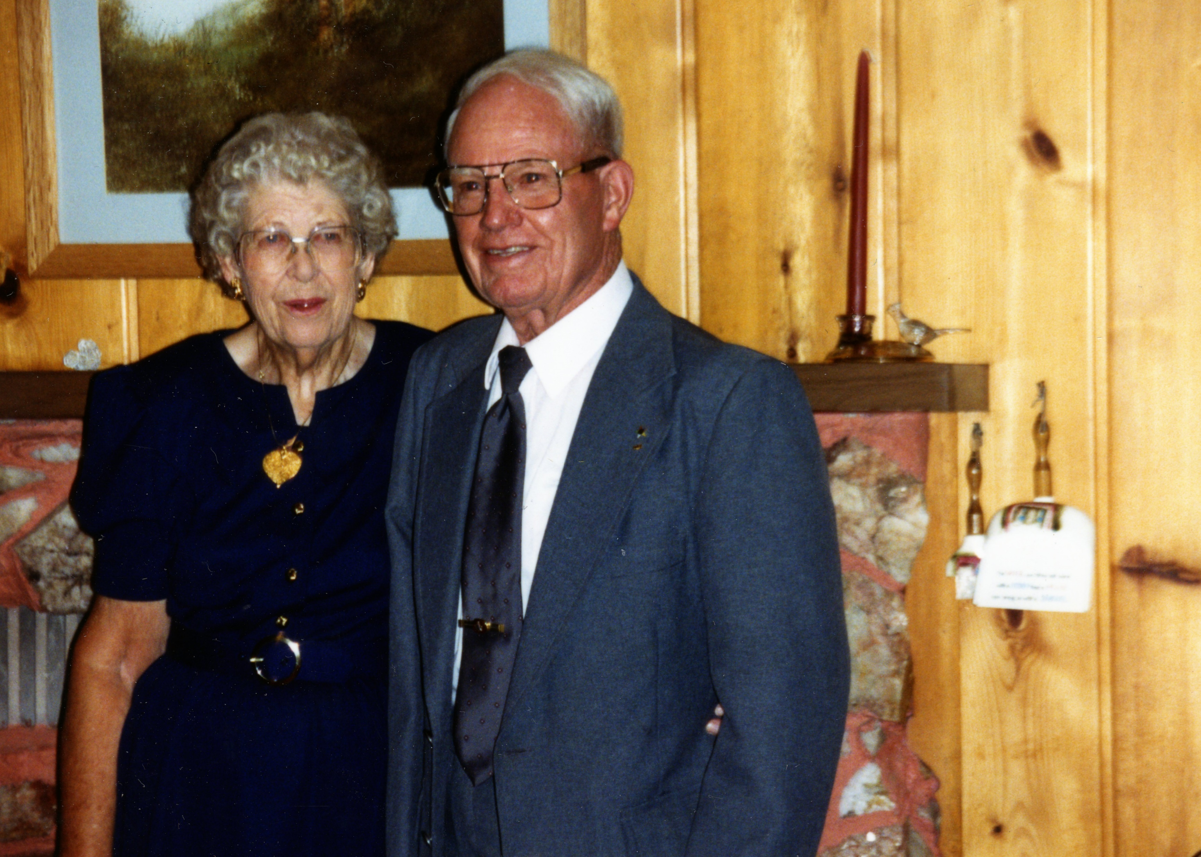
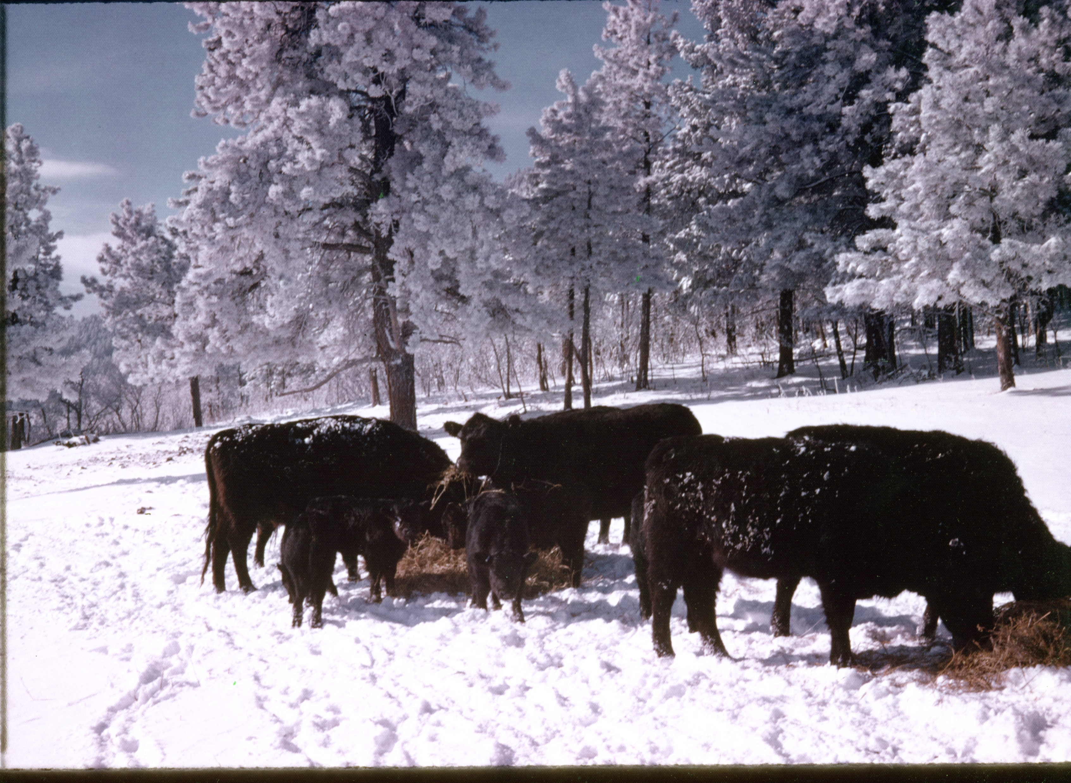
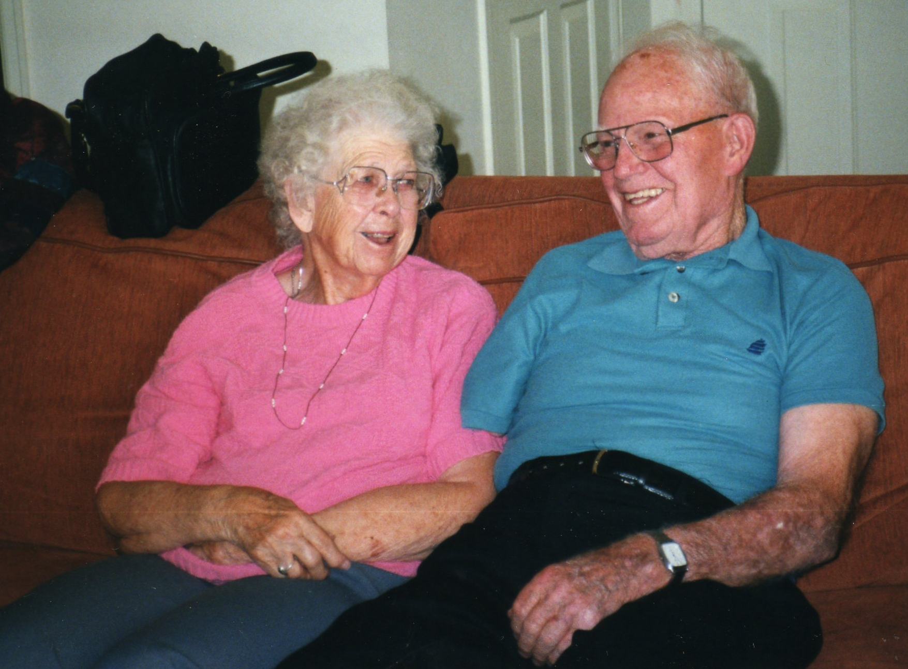
Russell and Amy at home on Casa Loma Ranch
Russell and Amy’s Purebred Angus
Russell (1909-2008) married Amelia (Amy) Stewart after graduation with a degree in Animal Husbandry from Colorado A&M in Fort Collins. In 1942 he took a position as ranch manager in Steamboat Springs, Colorado. Russell, Amy, and daughters Shirley and Beverly moved to Steamboat Springs where he became manager of 2 different Angus cattle ranches.
The story is that the owner of the second ranch sold the cattle and Russell to a ranch in Watsonville, California. The family moved to California in December of 1948.
In August of 1949 Russell bought the Higginson Ranch from Harold and Essie’s. After returning from California in the Spring of 1950, Russell and family raised Red Angus and later about 50 head of Registered Black Angus. Holstien cows were milked and cream taken to Colorado Springs. Electricity was installed, repairs made and oats were planted and harvested. Meadow hay was mowed and bailed as normal ranching continued.
During this time the Higginson’s were active in their community. Amy used their 1939 Ford to drive the Greenland school bus picking up students. She was an active member of the Palmer Lake Columbine Home Demonstration Club and The Friendly Larks Home Demonstration Club, the Republican Club, and helping the girls with school and Rainbow for Girls activities. Russell was 4-H leader for 10 years and helped with the Douglas County Fair, and a member of Masonic Lodge. Both Amy and Russell were members of The Order of Eastern Star. The Higginson’s were active members of the Little Log Church in Palmer Lake.

Slide 17
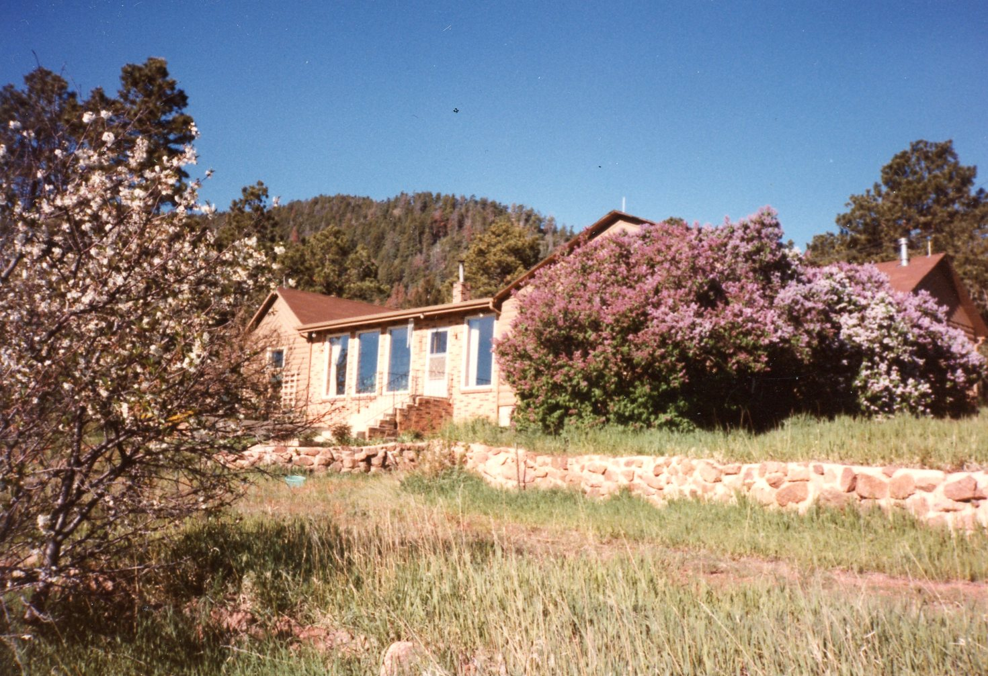
Russell and Amy
Casa Loma Ranch Home
To supplement their income Russell drove the Douglas County School bus, was Douglas County Commissioner for 16 years, cut Evergreen boughs and Christmas trees and took them into Denver to be sold, dug many basements with his bull dozer and sold gravel to the State Highway Department.
In 1955 Perry and Isabelle Griener purchased the lower 360 acres of the Russell Higginson ranch. The Greiner’s agreed to lease the land to Russell and Amy to continue the cattle and haying business. This lease continued until about 1973. During these years Russell continued to run his Angus cattle and harvest the hay. In the summer of 1958 while harvesting the Brome grass, Russell accidentally caught his right arm in the rotating round hay bailer and had to have it amputated.
After selling the lower 360 acres in 1955, Russell and Amy chose a site on the west side of Perry Park Road and with the help of others cut logs, took them to Frank’s sawmill in Monument. They used these sawn logs to build their new house and ranch buildings. The Higginson family moved into the unfinished house the summer of 1955. These 680 acres became known as the Casa Loma Ranch.
In 1969, Lee Stubblefield the President of Colorado Western Development was promoting the Perry Park Subdivision and bought 560 acres of the property leaving 80 acres and buildings for the Casa Loma Ranch. The Colorado Western Development failed, and his land was sold to Del Harper developer of Hawk Ridge.
As Russell and Amy aged, they became unable to manage the ranch. Beverely and Bill Noe and Shirley Eyerly leased the ranch until their parents’ deaths. The 80 acres was put into a Douglas County Conservation Easement. Russell lived to be 98 and Amy 100. Both are buried in Bear Canyon Cemetery.

Slide 18
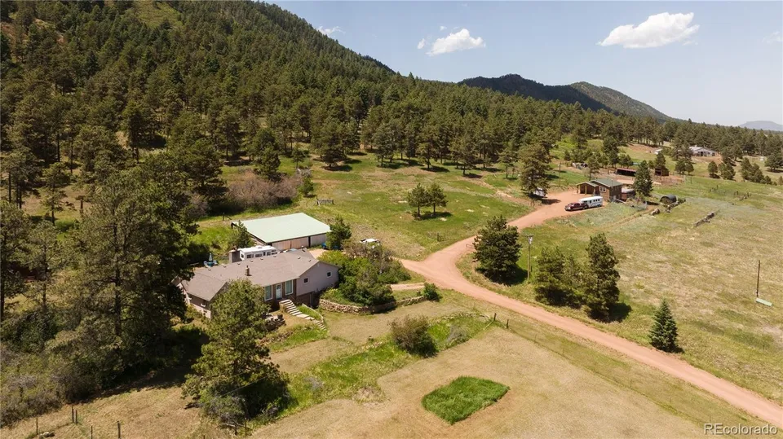
Casa Loma Ranch buildings including Browneller’s
After the death of Amy and Russell, Shirley inherited 35 acres including the buildings and Beverly inherited 45 areas. After Shirley’s death, her acreage was sold to settle her estate.
Beverly’s acreage was deeded to Bill and Beverly’s daughter Linda and husband Terry Browneller. The Browneller’s built a new house and still live on a piece of the Casa Loma Ranch.
Members of the Harold Higginson family have owned portions of the ranch since 1907 until the present day (2026). (119 years)
A Douglas County Conservation Easement is on the 680 acres of the original Casa Loma Ranch.

Slide 19
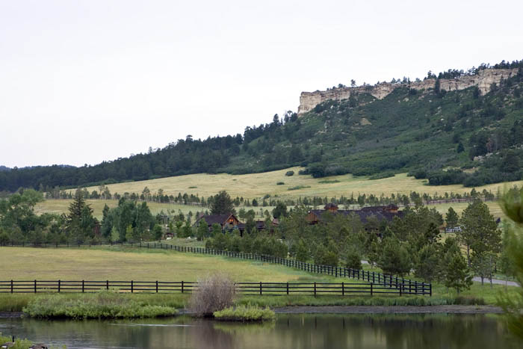
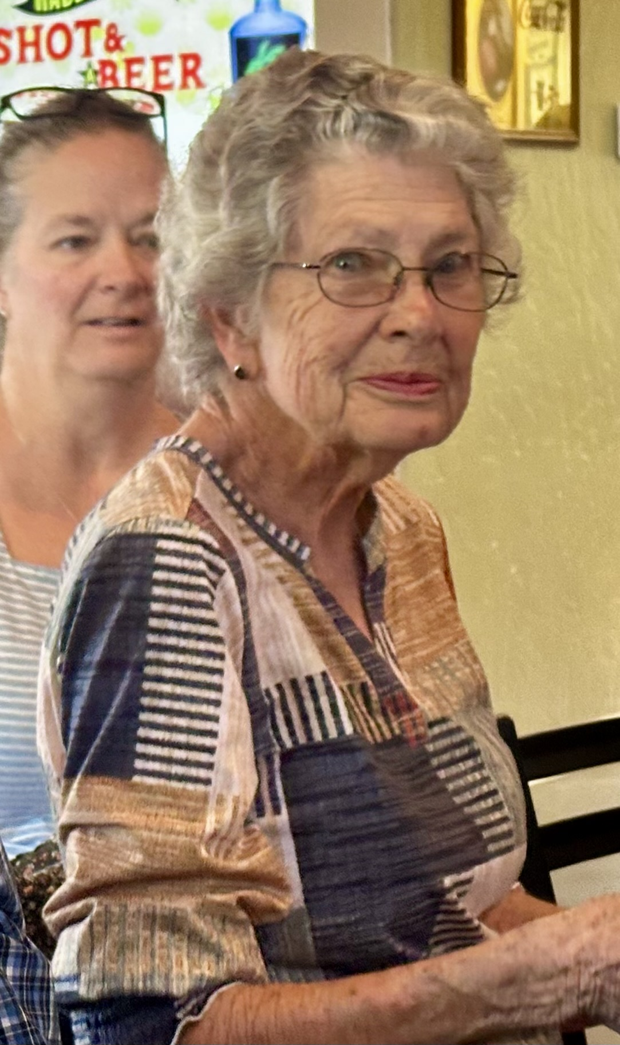
In 1955 Perry and Isabelle Griener purchased the lower 360 acres of the Russell Higginson ranch. The Greiner's agreed to lease the land to Russell and Amy to continue the cattle and haying business. This lease continued until about 1973. During these years Russell continued to run his Angus cattle and harvest the hay. In the summer of 1958 while harvesting the Brome grass, Russell accidentally caught his right arm in the rotating round hay bailer and had to have it amputated
The 360 acres was sold several times during the years. It is now the Spruce Mountain Ranch and Event Center. The Higginson family is happy to see Black Angus Cattle and not houses on the land.
Spruce Mountain Ranch and Event Center
Beverly Higginson Noe

